Slide 1





Curriculum B: T2: Inclusive Workplace Cultures

Slide 2

CONTENTS
01
Objective of the Module
02
Introduction - Inclusive Workplace Culture
03
DEI Frameworks for Enterprises
04
Group Exercise

Slide 3

01
Objective

Slide 4
Module Focus:
Recognise the elements of an inclusive workplace culture
Establish communication norms that reduce conflict
Introduce simple mechanisms for listening to employee experiences
Respond constructively to cultural misunderstandings
Build a safer, more supportive environment for all staff
01 Objective

Slide 5

02
INTRODUCTION

Slide 6

Why Workplace Culture Matters:
Workplace culture shapes how employees experience their day-to-day work
Inclusive cultures foster trust, cooperation, and engagement
Exclusion—often unintentional—can create misunderstandings and disengagement
These dynamics directly influence retention and staff turnover

Slide 7
Benefits and Challenges for the employer
Benefits:
Improved collaboration and productivity
Reduced conflict and miscommunication
Stronger employee retention
Better use of existing skills within the workforce
Challenges:
In many cases, challenges arise not from a lack of goodwill, but from unclear expectations, unspoken norms, or differences in communication styles.

Slide 8

Core Elements of an inclusive Workplace
Psychological safety
Clear and respectful communication norms
Fair and transparent processes
Regular opportunities for employees to share experiences and feedback
Constructive approaches to addressing misunderstandings
Source:
Edmondson, A. C. (2018). The Fearless Organization
Ferdman, B. M. (2014). The Practice of Inclusion in Diverse Organizations

Slide 9
Implications of Inclusive Workplace Culture
An inclusive workplace culture is one in which employees:
Feel safe to speak up and ask questions
Feel respected, regardless of background, personal characteristics, hierarchy level
Feel a sense of belonging within the team
Are able to contribute their skills, ideas, and opinions openly and effectively
-> But how do you establish an inclusive workplace culture?

Slide 10
03
DEI Framework

Slide 11

1
Awareness
2
Communication and Behaviour
3
Organisational DEI System

Slide 12
Awareness
Understanding that employees may have different backgrounds, communication styles, and expectations.
= Listening to Employee Experiences
Tool:
Anonymous employee survey to identify status quo at the organisation and needs for employees

Slide 13
2. Communication (1/2)
Creating safer spaces where employees feel comfortable to speak up, ask questions, and share ideas
Practical actions: regular check-ins, clear meeting rules, and inclusive facilitation by managers
Establishing shared communication norms to reduce misunderstandings and conflict (e.g. asking for clarification rather than making assumptions)

Slide 14
2. Communication (2/2)
Inclusive practices include making expectations explicit and addressing issues early
Awareness of cultural differences in communication supports trust, learning, and collaboration

Slide 15
Organisational
Diversity, Equity & Inclusion (DEI) - System
Definition:
Establishing policies and processes that support fairness and inclusion.
Such as: DEI policy, onboarding practices, feedback mechanisms, and clear procedures for raising concerns
Supports external recognition/image of employer (“employer branding”)

Slide 16
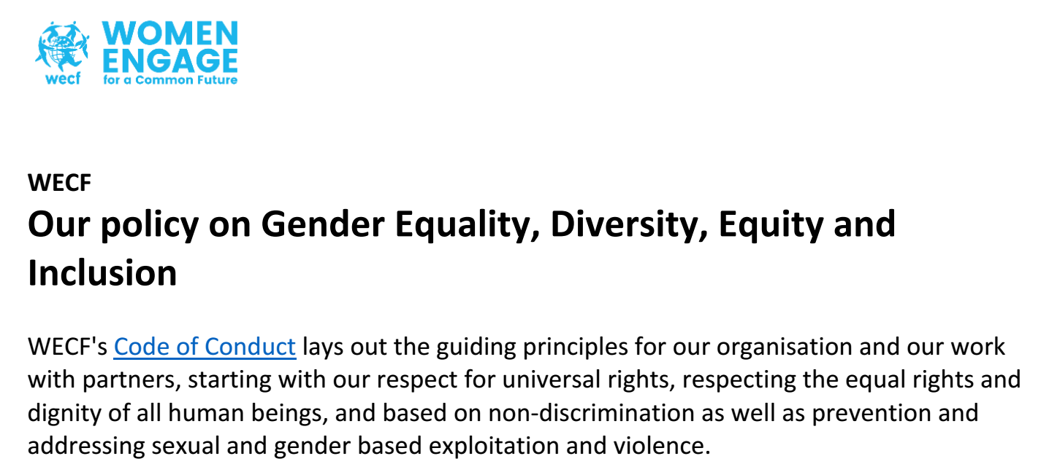
Example DEI-Strategy WECF
Source: WECF 2018,
Our policy on Gender Equality, Diversity, Equity and Inclusion

Slide 17

“WECF aims to attract and retain diverse human resources talent, to embrace different
perspectives and enhance cross-team collaboration”
Source: WECF 2018,
Our policy on Gender Equality, Diversity, Equity and Inclusion

Slide 18
Example: Joining the EU - Diversity Charter
Employers, with their HR, explore and consider signing up to the Diversity Charter in their respective countries. By signing a diversity charter, an organisation commits to promoting diversity and equal opportunities for its staff.
Source: EU Diversity Charter (2026), https://eu-diversity-inclusion.campaign.europa.eu/eu-platform-diversity-charters_en?prefLang=en

Slide 19
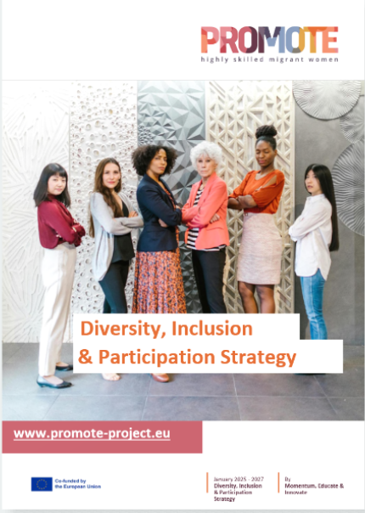
Example: DEI Strategy of the PROMOTE Project
Embedded principles of diversity,
inclusion, and participation are
not only embedded in the PROMOTE
project methodology but also
in all the resources created
Source: https://promote-project.eu/diversity-inclusion-participation-strategy/

Slide 20
Recruitment and Onboarding
Cultural Differences & Refugee Context
Why this matters: Recruitment is shaped by cultural norms and by life circumstances — not everyone enters the labour market on an equal footing.
Key points for employers
Cultural differences affect recruitment
Communication styles, attitudes to hierarchy, feedback, and self-promotion vary across cultures.
Refugee experiences add complexity
Many refugees face displacement, career interruptions, legal insecurity, and high stress.
Impact on hiring & onboarding
  CV gaps ≠ lack of skills
  Lower confidence ≠ lower competence
  Stress may affect communication and focus
Good practice
Use clear processes, avoid cultural bias in interviews, and offer structured onboarding.

Slide 21
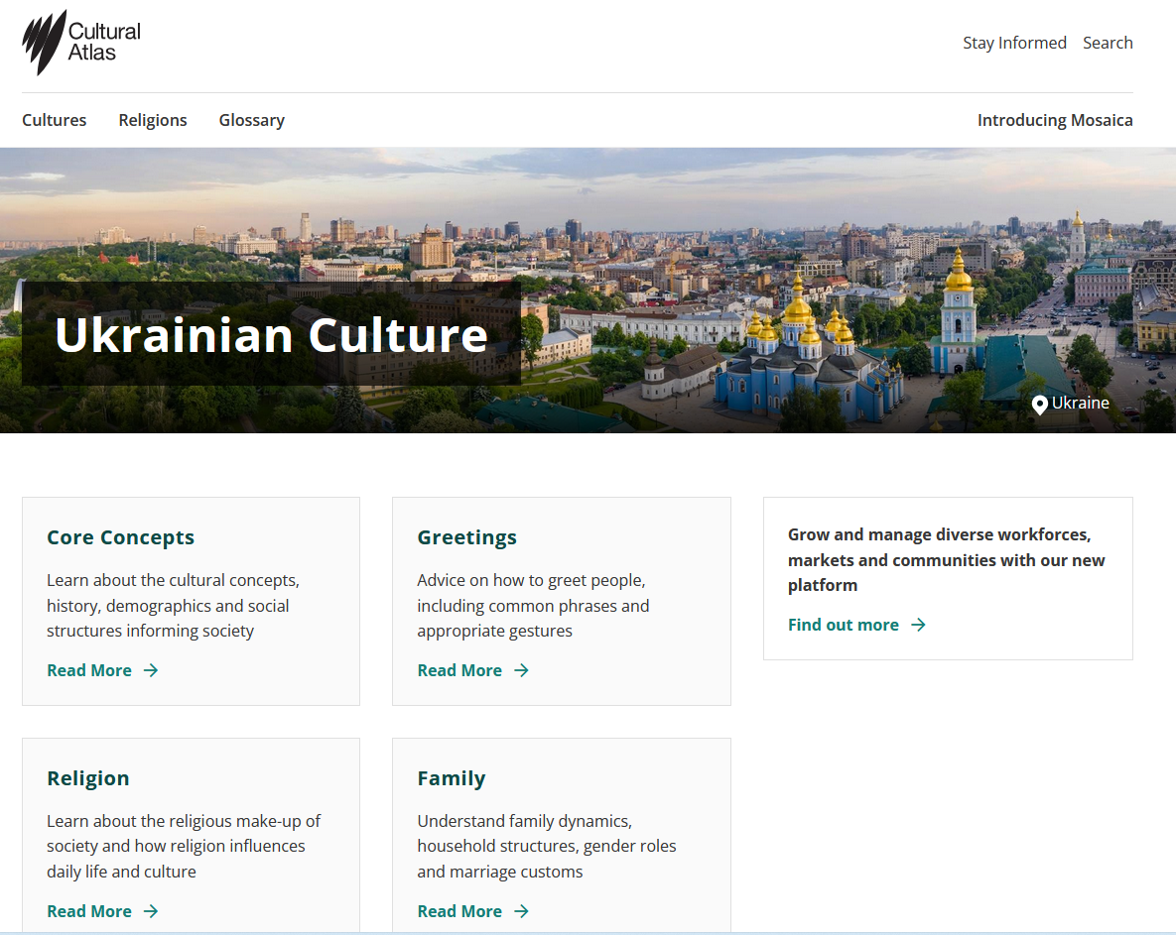
Recruitment and Onboarding
Source: https://culturalatlas.sbs.com.au/ukrainian-culture

Slide 22
Working with Ukrainian Women Refugees
Ukrainian women refugees often combine war-related trauma, gendered expectations, and high professional skills.
Key considerations
War & care responsibilities
Many are widows, single parents, or have partners fighting or injured due to the war.
Gendered cultural norms
Strong sense of duty, reliability, and quality of work — often less self-promotion in interviews.
Highly skilled profiles
Many have backgrounds in STEM, technical, engineering, or medical fields, with under-recognised qualifications.
What employers can do
Assess skills beyond confidence and “selling oneself”
Actively recognise qualifications and experience
Offer clarity, flexibility, and psychologically safe onboarding
Key message
Inclusive recruitment means seeing Ukrainian women refugees as both skilled professionals and people shaped by extraordinary circumstances.
Source: https://uwf.org.ua/en/

Slide 23

Group exercise:
Work together in small groups and share best practice examples from your own experience. Keep the discussion practical and solution-oriented.
How can misunderstandings be avoided in daily collaboration?
Context: Consider different cultures, differences which might influence communication
Are there already guidelines in place ?
If yes – are they working?
If not – what should be created or improved?

Slide 24

Call for Action - Using the session´s momentum
Action plan: Will you try to start something in your work
regarding DEI after this session?
If yes, how could it look like?
How do you monitor progress in the future
(e.g., surveys, feedback, metrics)?

Slide 25
More information :
Cultural Atlas (2026), https://culturalatlas.sbs.com.au/ukrainian-culture
WECF (2018), Our policy on Gender Equality, Diversity, Equity and Inclusion
EU Diversity Charta (2026), https://eu-diversity-inclusion.campaign.europa.eu/eu-platform-diversity-charters_en
EU Diversity Self Assessment Tool (2026) https://vo-europe.swoogo.com/self-assesment-tool
Edmondson, A.C. (2018) The Fearless Organization: Creating Psychological Safety in the Workplace for Learning, Innovation, and Growth. Hoboken, NJ: Wiley.
Ferdman, B.M. (2014) ‘The Practice of Inclusion in Diverse Organizations: Toward a Systemic Whole’, in Ferdman, B.M. and Deane, B.R. (eds.)
PROMOTE Project (2024), https://promote-project.eu/diversity-inclusion-participation-strategy/

Slide 26

Follow our journey
li
in
www.promoteproject.eu

