Slide 1





Career Reintegration for Highly Skilled Migrant Women

Slide 2

Module 4
Building My Future Here
Succeeding in My New Workplace

Slide 3

CONTENTS
01
Cultural integration
02
Workplace Communication
03
Resilience at work
04
Creating a workplace buddy system
05
How Workplaces Read You

Slide 4

Learning Outcomes
By the end of this module, learners will be able to:
Describe how workplaces function in a new cultural and professional context.
Recognise informal workplace rules, expectations and communication styles.
Apply strategies for clearer communication in professional situations.
Build confidence when navigating unfamiliar workplace environments.
Identify practical ways to strengthen resilience and access support at work.

Slide 5
Core Topics
¤
Cultural integration and informal workplace rules
¤
Workplace communication and feedback
¤
Resilience and handling challenges
¤
Networking, mentorship, and workplace behaviour
Notes:
And on this slide you can see the core topics

Slide 6

01
Cultural Integration
ABOUT US
Notes:
We’ll start by looking at the unwritten rules that shape everyday work

Slide 7
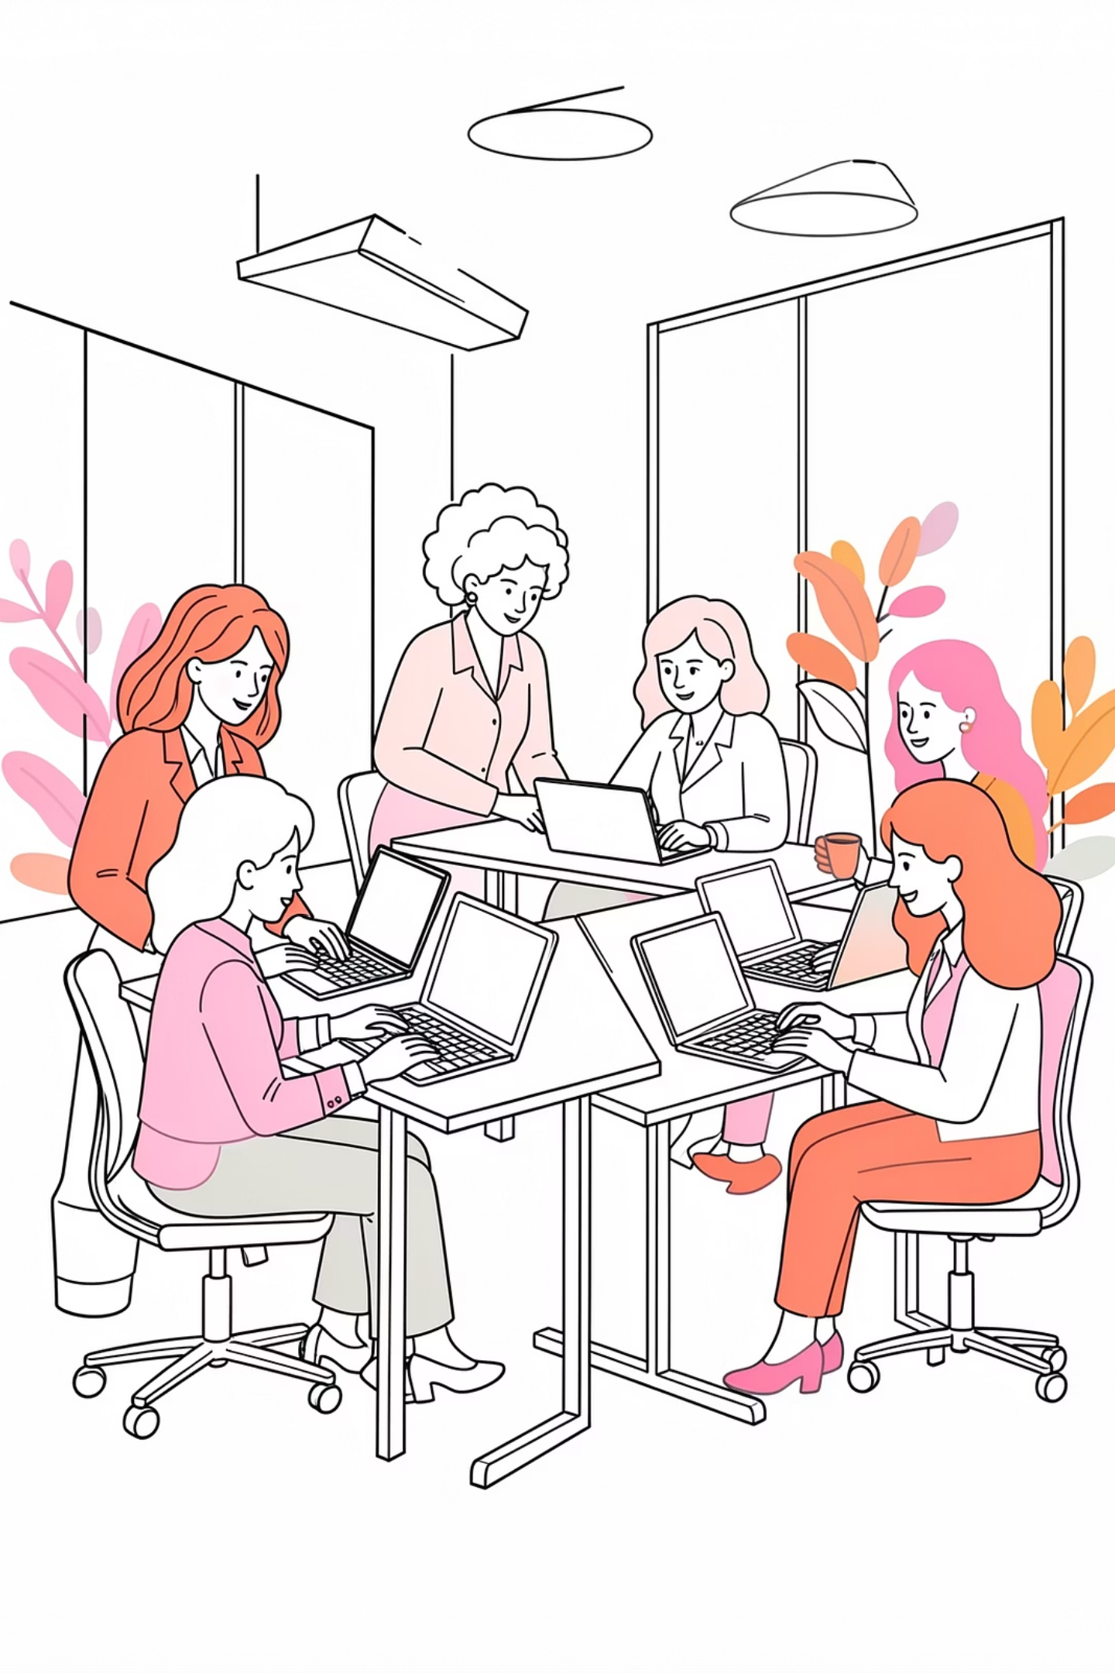

What Are Informal Codes?
Informal codes are the unwritten rules of a workplace. They shape how people communicate, take initiative, give feedback, respect hierarchy, and manage time.
They are not always explained clearly, but they strongly influence how people understand your behaviour at work.
Not knowing them does not mean lack of competence. It means you are learning a new professional context.

Slide 8

Common Workplace Patterns
In many European workplaces, communication may be indirect, feedback may be subtle, and employees may be expected to show initiative without waiting for detailed instructions.
Communication Style
Often indirect and nuanced. Reading between the lines is a valued skill in many professional settings.
Work-Life Boundaries
Punctuality, breaks, meeting behaviour, email expectations, and availability outside working hours all carry meaning.
Showing Initiative
Employees are often expected to act independently without waiting for detailed step-by-step instructions.
These patterns vary by country, sector, organisation, and team. The key skill is learning to observe, ask, and adapt.

Slide 9


How to Respond Confidently
When you are unsure, pause and look for signals. Notice how colleagues ask questions, disagree, give feedback, and manage deadlines.
You can clarify expectations directly and professionally:
Understanding informal codes helps reduce uncertainty and build confidence at work.
"Could you clarify what is expected here?"
"Would you like me to take the lead on this?"
"Can I check whether I understood correctly?"

Slide 10

Activity 1
Activity: Understanding Workplace Norms
Think of a situation that felt unclear
What rule might have been behind it?
How would you respond next time?
Notes:
Participants reflect individually or discuss in pairs.
Goal: connect theory to real experience.

Slide 11

02
Workplace Communication
Notes:
Now we move to how communication, feedback, and hierarchy really work

Slide 12

Why Workplace Communication Can Feel Unclear
Workplace communication is not only about the words people use. It is also shaped by tone, timing, hierarchy, confidence, and expectations.
Remember
Softened Phrases to Watch For
If communication feels unclear, it does not mean you are failing. It means you may need to read the context, ask questions, and check expectations.
"Maybe next time…"
"Let's think about it."
"That's an interesting idea."
These may still mean that a change is needed.

Slide 13

Receiving Feedback and Asking Questions
Feedback is not always given as a clear instruction. Sometimes it is implied through small comments, silence, or suggestions.
"What does success look like here?"
Clarifies the standard you are being measured
against before you begin.
"Is there a preferred way to do this?"
Uncovers unspoken norms or processes that may not
be written down.
"Can I check my understanding?"
Confirms alignment and prevents costly
misunderstandings later on.
Asking questions is professional. It shows that you want to do the work well and avoid misunderstandings.

Slide 14
Giving Feedback Respectfully
When giving feedback, it helps to use a safe, clear structure that keeps the conversation focused on
facts and shared solutions.
Example in Practice
Observation
Impact
"I noticed the deadline changed. This affected my planning. Could we agree on earlier notice next time?"
What happened? Describe the situation factually, without judgement.
Why does it matter? Explain the effect on your work or the team.
When hierarchy is involved, focus on questions, facts, and shared solutions. This helps you disagree professionally without making the situation personal.
Request
What could change? Suggest a concrete, forward-looking action.

Slide 15

Activity 2
Activity: Communication Practice
Practice asking a question:
“Can I check my understanding?”
Practice giving feedback using:
Observation – Impact – Request
Notes:
Participants work in pairs.
Focus on clarity and confidence, not perfection.

Slide 16

03
Resilience at Work
Notes:
Next, we’ll focus on how to protect confidence and energy at work

Slide 17

Resilience at Work
Resilience is not about tolerating poor treatment or "being strong" in silence. At work, resilience means protecting your confidence, managing stress, and choosing responses that keep you safe and professional.
Pause
Take a moment before reacting
Clarify
Ask for clarification when needed
Name It
Describe the impact of a situation
Seek Support
Reach out when things feel difficult

Slide 18

Common Challenges
Some women may face extra pressure when entering a new workplace, especially in a new country, sector, or language environment. These experiences are real — and the responsibility is not only on the individual.
Mutual respect at work means that both employer and employee recognise each other’s dignity, responsibilities and boundaries.
Impostor Feelings
Language Anxiety
Being Underestimated
Doubting your own skills and
belonging
Worry about accent or
expression
Interrupted or overlooked in
discussions
Unclear Expectations
Emotional Exhaustion
Vague or inconsistent feedback
Fatigue from constantly adapting

Slide 19

Understanding Microaggressions
Microaggressions are small comments, behaviours, or assumptions that can make someone feel excluded, judged, or less competent. One incident may seem small — but repeated incidents can affect confidence, belonging and mental health.
Comments on Accent
Remarks about "good English" or the way someone
speaks
Being Spoken Over
Interrupting or not allowing someone to finish their point
Assumed Seniority
Treating someone as junior or less skilled without basis
Cultural Misreading
Confusing cultural difference with lack of professionalism

Slide 20

Practical Responses
A useful response does not always need to be immediate. Safety, context and power dynamics matter. Choose the response that feels safest and most appropriate for the situation.
Clarify
Name the Impact
"What do you mean by that?"
"May I quickly finish this point before we
move on?."
Redirect
Pause
"Let's return to the task and agree the next step."
"I need a moment to think before I respond."
You do not need to respond perfectly in the moment. Any of these responses is a valid,
professional choice. Speak with respect and clarity: stay calm, listen to others, and express
your needs or boundaries without apologising for having them.

Slide 21

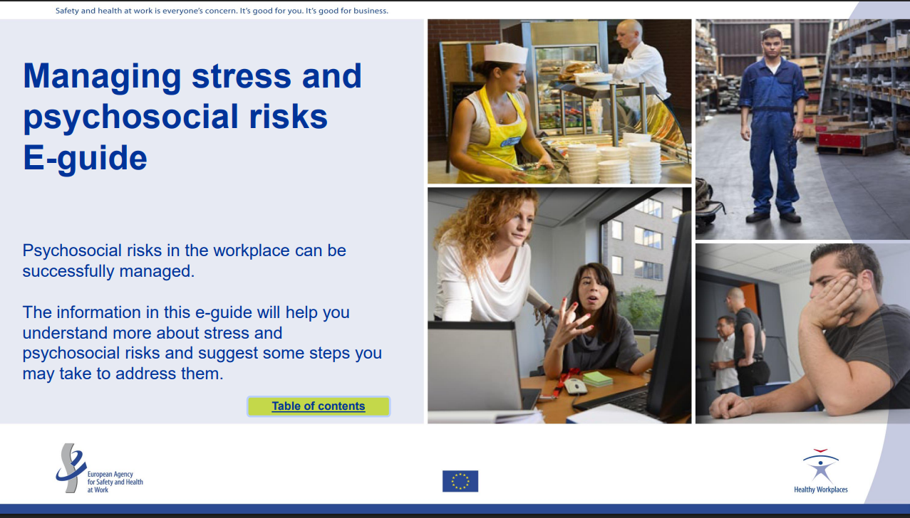
Research & Resources: Resilience at Work
CLICK ON THE IMAGE
Resilience at work is not only an individual skill. EU-OSHA stresses that work-related stress, anxiety and depression are major workplace health issues in Europe, and that psychosocial risks should be managed as organisational risks, not personal weakness.
This is especially relevant for migrant and refugee workers, who may also face language pressure, uncertainty, discrimination or insecure work.
A useful resource is the EU-OSHA e-guide to managing stress and psychosocial risks. It offers simple explanations, practical examples and first steps for preventing and dealing with stress at work. It can help learners recognise when workplace pressure is becoming harmful and identify what support, boundaries or changes may be needed. Visit the EU-OSHA e-guide →
Learning point: Resilience means recognising stress signals, using support, and responding strategically. It does not mean accepting unsafe, unfair or harmful working conditions.

Slide 22

Reflection
What challenge affects you most?
What helps you stay confident?
Notes:
Short individual reflection or group sharing.
Keep it safe and voluntary.

Slide 23

04
Creating a workplace buddy system
ABOUT US
Notes:
This part looks at how relationships help you integrate faster.

Slide 24

What is a workplace buddy system?
A workplace buddy system connects a new or less experienced employee with a trusted colleague who can answer everyday questions and explain how things work in practice.
Not a manager
For migrant professionals, a buddy can be especially useful because many workplace expectations are not written down. They are learned through people, observation and small conversations.
A buddy is not there to evaluate or direct your
work.
Not a therapist
Their role is practical, not emotional counselling.
Not a formal mentor
Their role is practical: helping someone understand the workplace, find information, ask better questions and feel less alone in the first weeks or months.
No structured programme or long-term development plan required.

Slide 25

Why a buddy system
matters
Starting in a new workplace can be stressful, especially when the language, culture or professional norms are unfamiliar. A buddy helps reduce that uncertainty from day one.
Informal rules
Explains how meetings work, how feedback is usually given, and what "normal" communication looks
like in that team.
Making introductions
Helps new employees connect with the right people
and understand who to ask for help.
Adjusting to the organisation
Supports new employees after formal orientation by
answering questions and helping them settle in.
Integration support
For migrants and refugees, buddy approaches build
links with people, services and local knowledge.

Slide 26
Buddy, mentor or network?
These three forms of support are useful, but they are not the same. The strongest support
system often includes all three.
1
A buddy
Helps with short-term, practical questions: "How do meetings work here?" "Who should I ask about this?" "What is the usual way to communicate this?"
2
A mentor
Supports longer-term development: "What career path could I take?" "How can I grow in this sector?" "What skills should I build next?"
3
A network
Gives access to people, information and opportunities beyond one relationship.

Slide 27
How to create a buddy system
A buddy system can be organised by the employer, but it can also be self-initiated. Here is how to get started.
01
Choose the right person
Look for someone approachable, respectful and familiar with the workplace culture.
02
Make a clear, limited request
Be specific about what you are asking for and keep the scope manageable.
03
Agree simple boundaries
Decide how often to check in, what kind of questions are appropriate, and when to review whether it is still useful.
04
Build towards independence
The goal is to become more confident, informed and independent — not to create dependence.

Slide 28
How to create a buddy system
"Would you be open to being a workplace buddy for my first few weeks? I would mainly ask practical questions about how things work here."
A good buddy relationship is practical support, not dependence. The goal is to help the new employee become more confident, informed and independent.

Slide 29
SOURCES USED
CIPD - Employee induction guide
https://www.cipd.org/uk/knowledge/guides/employee-induction/
London School of Economics - New Starter Buddy Guidelines PDF
https://info.lse.ac.uk/staff/divisions/Human-Resources/Assets/Documents/OLL/New-starters-buddy-guide.pdf
London School of Economics - New Starter Buddy System
https://info.lse.ac.uk/staff/divisions/Human-Resources/Organisational-learning/Staff-new-starter-hub/Buddy-system
Loughborough University - Guide to Being an Induction Buddy PDF
https://www.lboro.ac.uk/media/media/services/organisationaldevelopmenthub/downloads/Guide%20to%20Being%20an%20Induction%20Buddy.pdf
EU-OSHA - Psychosocial risks and mental health at work
https://osha.europa.eu/en/themes/psychosocial-risks-and-mental-health
EU-OSHA - E-guide to managing stress and psychosocial risks
https://osha.europa.eu/en/tools-and-resources/e-guides/e-guide-managing-stress-and-psychosocial-risks
EU-OSHA e-guide platform - Managing stress and psychosocial risks
https://eguides.osha.europa.eu/all-ages/eu-osha-e-guide-managing-stress-and-psychosocial-risks
European Parliament - Labour market integration of asylum-seekers and refugees
https://www.europarl.europa.eu/thinktank/en/document/EPRS_BRI%282021%29690651
European Parliament - New approaches to labour market integration of migrants and refugees PDF
https://www.europarl.europa.eu/RegData/etudes/STUD/2024/754232/IPOL_STU%282024%29754232_EN.pdf
LABOUR-INT - Integration of refugees, asylum seekers and migrants into the labour market
https://www.labour-int.eu/
OECD - Labour Market Integration of Refugees in Germany
https://www.oecd.org/en/publications/labour-market-integration-of-refugees-in-germany_14947519-en.html

Slide 30

05
How Workplaces Read You:
Clothes, Conduct, and Mistakes
ABOUT US
Notes:
Finally, we’ll cover everyday signals that strongly affect how you’re read at work.

Slide 31

How Workplaces Read You
Clothing, Conduct & Correcting Mistakes
— your silent professional language
First Impressions
Nearly 80% of people form an impression within seconds — before you speak a word.
Dress for the role and context, so your clothes support your competence instead of distracting from it.
Choose clean, appropriate and comfortable clothing, and avoid anything that makes you feel unsure or exposed.
When you make a mistake, own it quickly, explain the fix, and show integrity through your next action.

Slide 32
How Workplaces Read You
Clothing
Simple, clean, well-fitted, and appropriate for your
environment
Detail
Shoes, bags, and accessories complete —
or undermine — your look
Avoid
Neon shades, outdated styles, overly tight silhouettes
Mistakes
Acknowledge · Take responsibility · Offer a solution
Dress appropriately, act with integrity, and handle errors with
grace — trust and credibility follow.

Slide 33

Key takeaways
Workplace rules may be different, not better or worse
Understanding expectations builds confidence
Communication can be learned and improved
Small actions lead to progress
Explore workplace etiquette resources or short videos for additional guidance
Notes:
Here are the key takeaways.
Your skills did not disappear when you moved countries.
What changed is the system and the informal rules.
Understanding the rules reduces stress and increases control.
Confidence grows with understanding and small actions — not with perfection.
Adaptation does not mean losing identity: It means understanding how to navigate the environment effectively.

Slide 34
Resources
Manage Stress & Resilience
Build Confidence at Work
Practice real work tasks in a safe environment
Find Local Professional Communities
Take one small step forward today!
Notes:
At this stage, the goal is not to do everything at once, but to take one or two practical next steps.
You can start by reviewing your CV or LinkedIn profile and making sure your skills and experience are clearly presented.
If you have developed a digital portfolio, this is a good moment to update it and make sure it reflects your strengths and goals.
You can also begin exploring opportunities for Work-Based Learning, such as job shadowing, mentoring, or short projects. These can help you gain local experience and better understand how workplaces function.
In addition, consider reaching out to local support organisations, networks, or contacts who can guide you or connect you to opportunities.
The most important thing is to take a small, concrete action after this session. Progress often starts with simple steps.

Slide 35

Follow our journey
li
in
www.promoteproject.eu

