Slide 1





Career Reintegration for Highly Skilled Migrant Women

Slide 2

Module 3
Owning my Career Path
Confidence, Communication and Career Networks

Slide 3

CONTENTS
01
Learning Objectives
02
Building Confidence
03
Interview Skills
04
Networking
05
Mentorship

Slide 4

Learning Outcomes
By the end of this module, learners will be able to:
● How to strengthen our confidence, represent ourselves professionally, and communicate about our professional experience.
● Interview, networking, and job-search skills.
● How mentorship can support my personal and professional development.

Slide 5

01
Learning Objectives

Slide 6

Core Topics
1. Confidence Building: Tackling imposter syndrome and cultural expectations.
2. Interview Skills: Answering behavioural questions and demonstrating competence confidently. Using professional language.
3. Networking: Where and how to find connections?
4. Mentorship: Understanding mentor-mentee relationships, how to find a mentor, and how to mentor others.

Slide 7

02
Building Confidence

Slide 8
This is an important topic, especially for Ukrainian and migrant women rebuilding careers after displacement, caregiving, or career gaps. Confidence loss is often not about competence, but about disrupted identity, unfamiliar systems, and language/cultural barriers.
Ask yourself the question,
“When did you last feel capable at work?”
(1 minute reflection, then share in pairs.)
Here are some practical confidence- building techniques to practice.
Where to start?
Success Stories
Ireland:
MI-WOW Success Stories | New Communities Partnership
Germany:
Empowering Journeys: Success Stories of Migrant Women in Germany
Poland:
One Woman’s Mission Turns Compassion Into Action for Migrants in Poland | IOM Storyteller
Spain:
WAFIRA project in Spain - Migration and Home Affairs - European Commission
Sweden:
Work and refugee integration in Sweden - Forced Migration Review

Slide 9

01
Body Confidence – Power Posture
Stand upright, shoulders open, feet grounded.
Breathe deeply for 2 minutes.
Practice introducing yourself slowly and clearly.
02
My Professional Identity
List 5 skills from previous roles, 3 strengths & 3 life skills gained from migration
Write, I am statements e.g. I am punctual and efficient.
03
Turn your Gap into Growth
Write your ‘gap story’: “I supported my family’s transition and managed our finances.” “I learned…X”
Practice saying it out loud to a small group
Be open to supportive feedback

Slide 10

Challenge
Imposter Syndrome
This often masks:
Loss of status after migration
Accent or language insecurity
Cultural code-switching fatigue
Internalised stereotypes
Pressure to “prove you deserve to be here”
Many migrant women were highly competent in their home countries, but they must rebuild credibility from scratch.
Reframe it: “I am not an imposter. I am adapting to a new system.”
Tip: Create a ‘wins’ diary with evidence of praise and positive feedback.

Slide 11

Challenge
Cultural Expectations
Many migrant women face dual pressures:
“Be successful but don’t become too independent.”
“Earn money but prioritise caregiving.”
Things to consider instead:
Define your personal success values.
Communicate boundaries clearly.
Allow space for evolution.
You can honour your background without shrinking yourself.
Tip: Integrate your culture as an asset. Humility → collaborative leadership, Family loyalty → long-term relationship building, Multilingualism → cross-cultural intelligence.

Slide 12
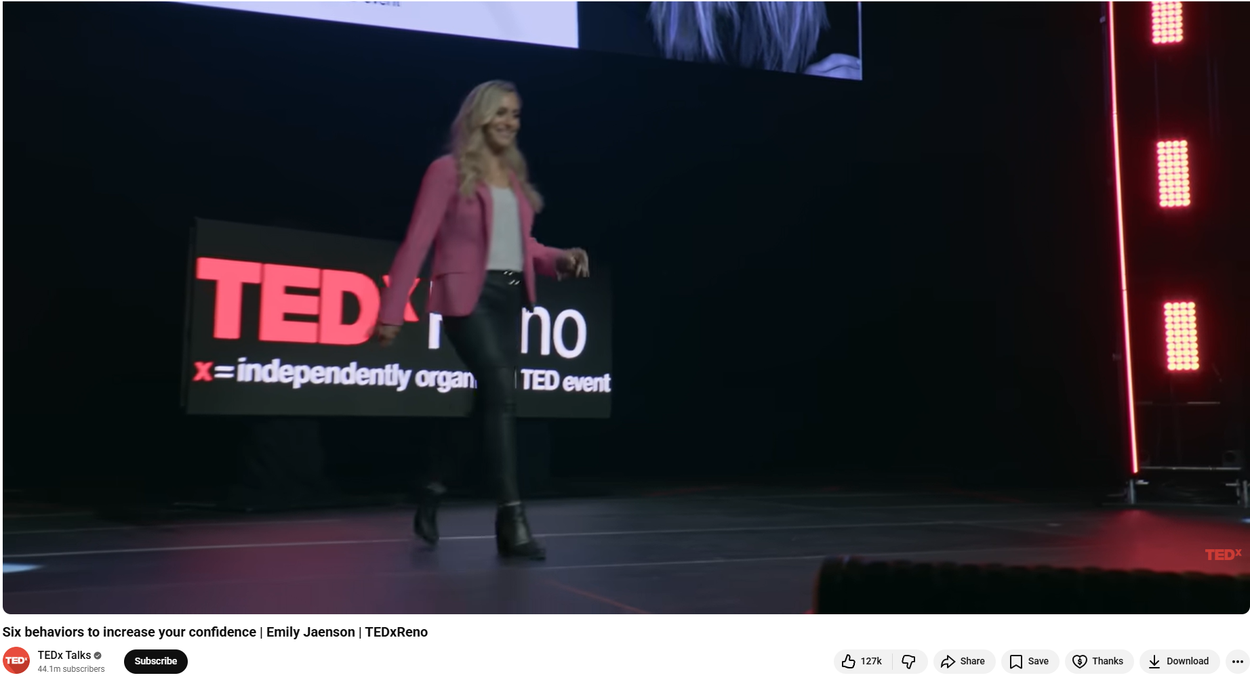
6 behaviours to increase your confidence
Six behaviors to increase your confidence | Emily Jaenson | TEDxReno

Slide 13

A LITTLE PROGRESS EACH DAY ADDS UP TO BIG RESULTS

Slide 14

03
Interview Skills

Slide 15
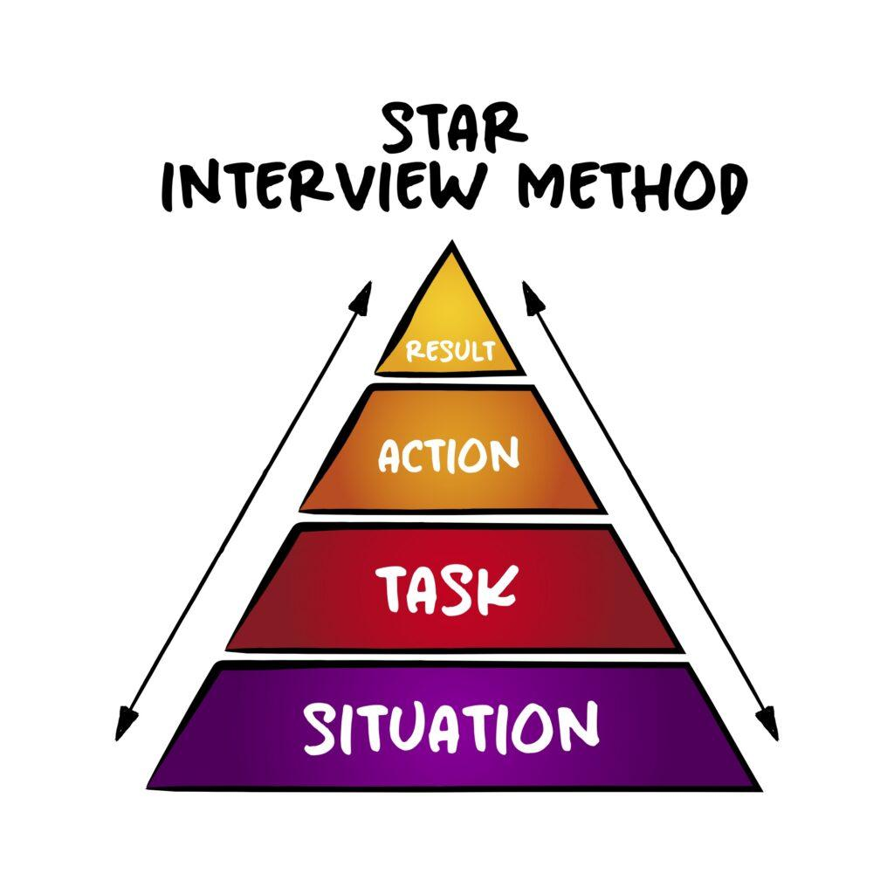
Preparation
Job interview skills for migrant women are not about “fitting in”; they’re about communicating your value clearly and confidently in a new context. Here, the focus is on practical interview preparation, ensuring participants can confidently communicate their skills and experiences.
1. Research the Employer
Understand the company’s mission and values,
Review the job description carefully
Prepare examples that match their required skills.
Use platforms like LinkedIn and Indeed
2. Use the STAR method to create 3-5 strong stories :
Situation
Task
Action
Result

Slide 16
STAR method in action
Situation: A communications professional relocated from Ukraine to Ireland due to the Russian invasion of Ukraine. Despite 8+ years of experience, she faced challenges including language barriers, unfamiliar job market expectations, and lack of local professional networks.
Task: Her goal was to: Rebuild her professional identity in a new country, Secure employment aligned with her previous experience, Regain confidence in her skills and ability to contribute
Action: She took steps: Enrolled in a migrant support programme (career coaching, CV adaptation, interview training), Volunteered with a local NGO to gain Irish work experience, Actively expanded her professional network through events and LinkedIn, Practised English in professional contexts (presentations, meetings), Reframed her international experience as an asset (cross-cultural communication, adaptability)
Result: Secured a communications role within 6 months, Reported increased confidence in interviews and workplace interactions, Built a new professional network in Ireland, Transitioned from feeling like an “outsider” to a recognised contributor in her field.

Slide 17
During the Interview: Speak Clearly, Not Perfectly
A practical guide to interview success — no matter where you're from.
Your Accent Is a Strength
Ask for Clarification
Show Confidence
Your accent is not a weakness. Speak with intention — pause instead of rushing, and let your words land with clarity and confidence.
If a question is unclear, it's perfectly professional to ask for clarification. It shows thoughtfulness, not hesitation.
Confidence is communicated through body language and voice — maintain eye contact, sit tall, and speak at a steady, measured pace.
Translate Your Experience
Handle Difficult Questions
Your international background and transferable skills are genuine assets. Frame them in terms the interviewer can connect with — highlight adaptability, cross-cultural communication, and problem-solving across different contexts.
Be prepared for tough topics: gaps in your experience, lack of local experience, or non-local qualifications. Acknowledge them honestly, then pivot to what you bring to the table. Preparation turns potential stumbling blocks into moments of authenticity.
Ask Strong Questions
Follow Up After the Interview
Thoughtful questions signal genuine interest and strategic thinking. Ask about team culture, success metrics, or growth opportunities — not just salary and hours.
Send a brief, personalised thank-you note within 24 hours. Reference something specific from the conversation to show you were engaged and attentive throughout.

Slide 18
Exercise: Mock Interview Role Play
Objective
Practice clear, structured answers
Translate international experience effectively
Strengthen interview confidence
Group Roles (3 participants)
🧑‍💼 Candidate
👩‍💼 Interviewer
👀 Observer
Timing
8 min interview
5 min feedback
Rotate roles
Focus Areas
✔ Structured answers (STAR method)
✔ Confidence & body language
✔ Skills translation
✔ Clear examples & results

Slide 19
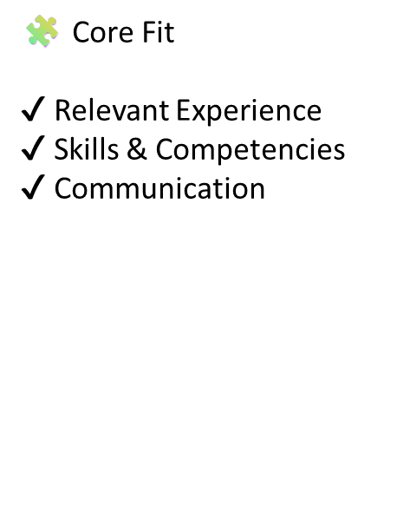
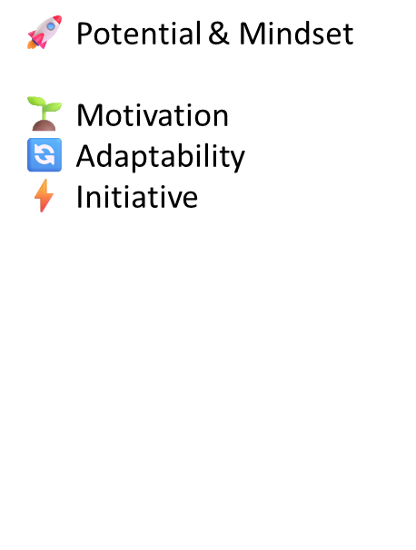
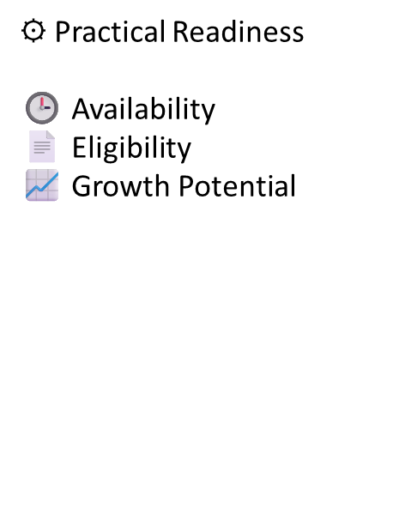
Recruitment Evaluation Criteria: an example
Scoring Guide: 1 (Limited) to 5 (Excellent)

Slide 20
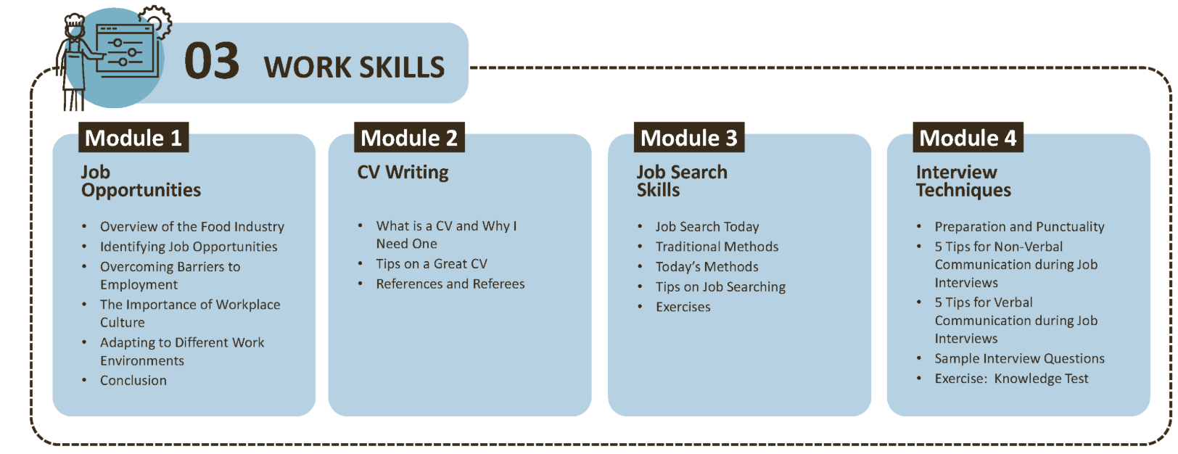
Discover work skills resource
WP3 - Steps to Employment Kitchen - 3 Kitchens

Slide 21

Exercise: Effective workplace communication
Workplace language supports safe, efficient, and confident performance in any role.
Brainstorming exercise: Your ideas…
What are the situations where you need to use a certain kind of language in the workplace?
How do you moderate/adapt your language according to a work situation?

Slide 22
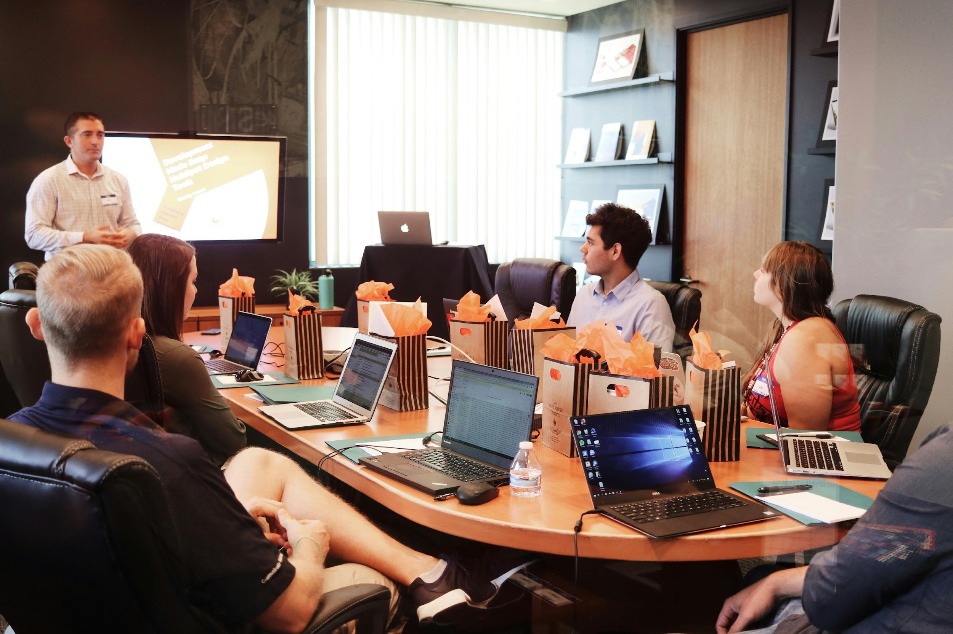
Q. Why workplace language matters?
To understand your rights and responsibilities
Discuss work schedules and availability
Describe and clarify job tasks
Process and communicate information (spoken and written)
Follow instructions in different formats
Offering suggestions or help
Asking for help or suggestions
Giving and responding to feedback
Interact professionally with customers or clients
Provide clear reports, both oral and written.

Slide 23
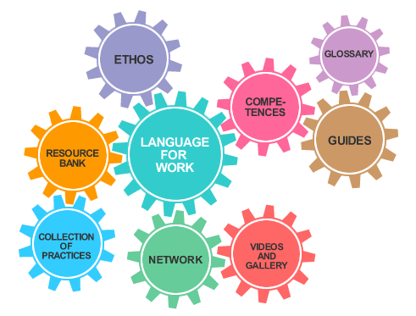
Exercise: Using Professional Language
Participants work with short, fictionalised professional scenarios (e.g. networking events, interviews, informal introductions, email exchanges) to explore different communication expectations and practice their language skills. Guided group discussion focuses on context, intention and clarity rather than assigning cultural or personal blame.
Useful resources:
https://languageforwork.ecml.at/en/
LFW-quick-guide-EN.pdf
Credit: https://languageforwork.ecml.at/en/

Slide 24
04
Networking

Slide 25

Finding and creating professional connections
Networking is often essential for career progression, but can be intimidating in a new country. It is a learnable skill rather than informal self-promotion.
Where to find connections?
Local Chambers of Commerce, Women’s Networks, Professional Associations, and LinkedIn.
How to initiate contact and maintain professional relationships? When sending a connection request: Short. Respectful. Specific.
Example
Hello [Name], I’m currently upskilling in [field] and was inspired by your work in [specific area]. As a professional building my path in [country/industry], I’d love to connect and learn from your experience. – Add something unique to you!

Slide 26

Exercise: Networking with Purpose
Participants explore and reflect on their professional networks (colleagues, mentors, industry contacts)
Their community networks (diaspora groups, local communities, volunteer circles)
Formal connections (work events, associations, structured programs)
Informal connections (friends, peers, online groups)
Low-pressure ways to connect, such as mentoring schemes, thematic events, and professional groups. E.g. (2) WeRin: Overview | LinkedIn

Slide 27

Creating an Elevator Pitch
Simple Formula to Remember
Name → Role → Strength → Proof → Direction
Step 1: Start with Who You Are
Name & professional identity (or direction you're moving toward)
Step 2: Highlight What You Do Well
1–2 key skills and your area of focus
A strength or unique perspective
Step 3: Share an Example
A recent achievement/project/result/certificate
Step 4: State Your Direction
What you’re looking for?
Who you’d like to connect with?
What kind of opportunities interest you?

Slide 28

To-Do List
1. Identify 5 local organisations or contacts relevant to your profession.
2. Map your existing network and identify gaps/opportunities.
3. Initiate professional conversations and connections via LinkedIn.
4. Shortlist relevant networking events to attend, e.g. International Women’s Day
Your network is a bridge to opportunities – even small steps build long-term professional connections.

Slide 29

“There is no limit to what we, as women, can accomplish."
Michelle Obama

Slide 30

05
Mentorship

Slide 31

The benefits
While navigating employment alone, mentorship offers numerous benefits, both personal and professional. Mentorship can be a powerful tool in your employability journey, especially if you are working in a niche area. Employers and professional organisations also offer mentoring.
By connecting with experienced migrant women who can support you via mentoring, you can gain valuable insights, develop new skills, and build a supportive network that will help you overcome challenges and achieve your employability goals. Here are three case study projects with more resources.

Slide 32

Understanding mentor/mentee relationships
It’s a structured learning partnership with a purpose of growth, either personal, professional or both.
For it to work, the roles must be clear. The mentor shares their experience, asks questions and offers perspective.
The mentee sets goals, prepares, reflects and takes action.
Trust is a key ingredient: there must be confidentiality, open communication, psychological safety and mutual respect.
The goal is empowerment to create confidence, strengthen decision-making and expand networks and opportunities so the mentee becomes less dependent over time.

Slide 33
Mentoring in action case studies
01
NatAlli
A community platform for mentors and mentees to connect and grow. Includes an assessment tool, toolkit and learning modules. Platform - Natalli Project
02
3 Kitchens
Training modules aimed at migrant women. Benefits, how to find a mentor and 3 Kitchen mentorship programme: Module 2.3 Mentorship Self Improvement Skills - 3 Kitchens
03
HeadStart
A mentorship and networking hub for women with a specific focus on AI skills. Directory of professionals who are inspiring the next generation of women in technology. HeadStart Networking & Mentorship Hub | Headstart
04
ReRootED
An EU-funded programme supporting displaced women in rebuilding their careers in Europe RerootED

Slide 34

Exercise: How to find a mentor & mentoring others?
Join a mentoring community e.g. NatAlli or HeadStart: Platform - Natalli Project
Self-assess your skills
Use your scores to create a Mentorship Action Plan together with your mentor.
Create your profile, including education, professional background.
Find a mentor based on filtering and matching functions.
Send a connection request and message a potential mentor.
Review the modules and online toolkit to upskill, taking guidance from your self-assessment scores and mentor.
Regularly review your Mentorship Action Plan to measure progress.

Slide 35

ReRootED – Career Support Programme
ReRootED is an EU-funded programme supporting displaced
women in rebuilding their careers in Europe and can be an
additional opportunity to complement the support presented in
this module.
It focuses on:
• identifying and strengthening existing skills
• supporting career orientation and transition
• providing structured training and practical tools
Participants benefit from:
• career development support
• skills mapping and self-assessment tools
• guidance in navigating the local labour market
More information: rerooted.eu

Slide 36

Module 3: Key Takeaways
At the end of Module 3, you are now better placed to Own Your Career Path by:
Building your confidence and overcoming barriers such as imposter syndrome and cultural misunderstandings.
Honed your interview skills using the STAR method and role play, as well as finding ways to build your professional network and grow your connections.
Understanding the benefits and opportunities that exist to find a mentor and mentor others as a powerful tool to gain support and support others in their professional development.

Slide 37
Useful Resources
Make it in Germany – Skilled Labour & Integration Portal
https://www.make-it-in-germany.com/en/
Official German Federal Government portal with practical information for skilled workers on living, working, integration, recognition of qualifications, language, and workplace culture.
Handbook Germany – Orientation & Local Services
https://handbookgermany.de/de
Multilingual information platform offering guidance on work, living, rights, and local services for newcomers in Germany (including Ukraine-specific sections).
Integration Services, Language & Communication Support
Integreat – Local Integration Information App
https://integreat.app/
Free mobile app providing local information (work, services, contacts) for refugees and migrants in multiple languages relevant to regions across Germany.
Jobcenter / Federal Employment Agency
https://www.arbeitsagentur.de/
Access to employment services, integration measures, benefits (Bürgergeld), activation vouchers (AVGS §45 SGB III), funding for language and vocational training, and childcare support tied to labour market insertion.
BAMF – Federal Office for Migration and Refugees
https://www.bamf.de/
Central federal authority running integration courses and job-related German language programmes (Deutsch für Beruf), supporting language acquisition up to B1 as a foundation for social and professional participation.
iOR SprachAcademy (Language Academy)
https://www.ior-languageacademy.com/
A major local language school in Freiburg and Lörrach is authorised to deliver BAMF-funded Integrationskurse and vocational language courses (A1–C1), including general German, professional German, orientation courses, and TELC exam preparation — a key regional provider for migrants, including refugees from Ukraine.
Goethe-Institut – German Courses & Intercultural Training
https://www.goethe.de/en/spr/mig.html
Language courses (A1–C2), workplace language preparation, and intercultural communication practice tailored for skilled migrants.

Slide 38
Useful Resources
Include plain-language and workplace-focused materials from Goethe’s Mein Weg nach Deutschland portal on the site for self-study.
Educational and Integration Counselling Centres
https://www.imib-freiburg.de/
https://www.freiburg.de/pb/,Lde/205420.html
Centres guiding language learning pathways, qualification recognition, and education/career planning for migrants and refugees.
Recognition and Social Support Services
https://www.drk-freiburg.de/
Support with administrative procedures, documentation, and qualification recognition assistance, including help navigating formal processes.
Psychosocial Support and Women’s Empowerment Organisations
https://www.suedwind-freiburg.de/
https://www.filia-frauenstiftung.de/
Organisations offering psychosocial counselling and empowerment programmes tailored to migrant and refugee women’s wellbeing and participation.
Employment Guidance and Networking Initiatives
https://www.engagiertes-freiburg.de/
https://www.dug-freiburg.de/
Local initiatives offering application coaching, mentoring, volunteer opportunities, and community-based networking forums, including for Ukrainian–German community integration.
PracawPolsce.gov.pl – job search and career resources: https://pracawpolsce.gov.pl
Fundacja SIM – career support for migrants: https://fundacjasim.pl
Barometr Zawodów – labour market demand: https://barometrzawodow.pl
https://www.kadryizatrudnienie.pl/
https://www.migrant.info.pl/
https://www.eurodesk.pl/

Slide 39
Useful Resources
Recruit Refugees Ireland — recruitment support for refugees, asylum seekers & migrants: https://recruitrefugeesireland.com/ (Recruit Refugees Ireland)
The Open Doors Initiative — supports employment access for underrepresented communities: https://www.opendoorsinitiative.ie/participants (Open Doors Initiative)
Women@Work (Business in the Community) — programme supporting women in sustainable employment: https://bitc.ie/programmes/jobseekers/women-work/ (Bitci)
Nasc – Migrant Rights Centre Ireland — advice & information for migrants: https://nascireland.org/ (en.wikipedia.org)
Doras – Migrant support organisation — advice and services for migrants: https://doras.org/ (en.wikipedia.org)
JobsIreland – Public Employment Service — official government job portal: https://jobsireland.ie/ (JobsIreland)
Jobs.ie – Jobs in Ireland — broad job listings: https://www.jobs.ie/ (www.jobs.ie)
IrishJobs.ie – Ireland jobs & careers — popular jobs platform: https://www.irishjobs.ie/ (www.irishjobs.ie)
Indeed Ireland – Job search engine — millions of listings: https://ie.indeed.com/ (Indeed)
RecruitIreland.com – Jobs & career resources — large Irish job board: https://www.recruitireland.com/ (RecruitIreland)
LinkedIn Jobs – Ireland work permit & professional roles — jobs via professional network: https://ie.linkedin.com/jobs/ (LinkedIn)
EURES – European Job Mobility Portal — jobs across Ireland & Europe: https://eures.europa.eu/jobseekers_en (EURES (EURopean Employment Services)
Migrant Women Network- ABOUT US - European Network of Migrant Women

Slide 40

Follow our journey
li
in
www.promoteproject.eu

