Slide 1





Career Reintegration for Highly Skilled Migrant Women

Slide 2

Module 2
Making Digital and Green Skills
Work for Me
Turning your skills into real job opportunities in Europe

Slide 3

CONTENTS
01
Introduction and Learning Outcomes
02
The EU Context
03
Understanding Digital Skills Properly
04
Understanding Green Skills Strategically
05
Labour Market Intelligence
06
Translating Experience into Employer Language
Notes:
Welcome & Overview
Introduction to today’s session
Activating confidence in your digital skills
Digital Identity
What is a digital identity?
LinkedIn, Europass, online portfolios
Why online presence matters
Professional Visibility
Writing a strong “About Me”
Using keywords to match job descriptions
Digital Tools for Employment
Job portals & CV builders
Digital Inclusion
Accessing devices & internet
Free online courses & community support
Sustainability & Green Skills
Understanding green skills
Applying sustainability in your profession
Linking skills to employer expectations

Slide 4
CONTENTS
07
Qualification Recognition and Strategic Upskilling
08
Positioning Your Professional Identity
09
Action Planning
Notes:
Welcome & Overview
Introduction to today’s session
Activating confidence in your digital skills
Digital Identity
What is a digital identity?
LinkedIn, Europass, online portfolios
Why online presence matters
Professional Visibility
Writing a strong “About Me”
Using keywords to match job descriptions
Digital Tools for Employment
Job portals & CV builders
Digital Inclusion
Accessing devices & internet
Free online courses & community support
Sustainability & Green Skills
Understanding green skills
Applying sustainability in your profession
Linking skills to employer expectations

Slide 5

Transformation
Europe is undergoing two major structural transformations:
The Digital Transition
The Green Transition
Together, they are reshaping:
Recruitment criteria
Skill demand
Professional standards
Sector growth
This module helps you strategically position your existing expertise within this context.

Slide 6
Learning Outcomes
By the end of this module, you will be able to:
Identify your existing digital and green competencies.
Understand how these align with EU labour market demand.
Recognise sector-specific opportunities linked to the twin transition.
Translate past experience into EU employer language.
Define one strategic upskilling or positioning action.

Slide 7

01
The EU Context

Slide 8

01
The European Green Deal
The Twin Transition: Structural Change in Europe
The European Union’s long-term strategy includes:
• Climate neutrality by 2050
• Circular economy development
• Sustainable infrastructure
• ESG reporting expansion
• Renewable energy growth
02
The Digital Decade Strategy
• Digital public services
• AI and data innovation
• Digital skills development
• SME digitalisation
• Platform economy expansion
These are not trends.
They are funded policy priorities driving labour demand.
Notes:
When we talk about the Twin Transition, we’re referring to the European Union’s coordinated push toward both green transformation and digital transformation.
Under the European Green Deal, the EU has committed to becoming climate neutral by 2050. This is driving investment in renewable energy, circular economy models, sustainable infrastructure, and expanded ESG reporting requirements. These policy commitments are already reshaping sectors such as construction, manufacturing, transport, and finance.
At the same time, the Digital Decade Strategy focuses on accelerating Europe’s digital capacity — expanding digital public services, strengthening AI and data innovation, increasing digital skills, supporting SME digitalisation, and growing the platform economy.
It’s important to stress: these are not temporary trends or market fashions. They are long-term, funded structural priorities backed by EU legislation and financial instruments. As a result, they are directly shaping labour market demand across Member States and influencing the skills employers now prioritise.
European Commission (2020) The European Green Deal. Brussels: European Commission.
European Commission (2021) 2030 Digital Compass: The European way for the Digital Decade. Brussels: European Commission.

Slide 9
What This Means for Professionals
Across sectors, employers now expect:
Data-informed decision-making
Process efficiency
Sustainability awareness
Regulatory literacy
Digital collaboration
Continuous upskilling
Digital and green skills are no longer specialist — they are transversal.
Notes:
What does this mean for professionals across sectors? First, employers increasingly expect data-informed decision-making. This goes beyond basic digital literacy. Professionals are expected to interpret data, understand performance indicators, and use evidence to guide strategy and operational choices.
There is also growing emphasis on process efficiency. Organisations are looking for individuals who can improve workflows, engage with digital systems, and contribute to productivity and innovation.
Sustainability awareness is now mainstream. Professionals are expected to understand how environmental and ESG priorities affect their sector — whether through reporting requirements, procurement standards, or organisational reputation.
Similarly, regulatory literacy is becoming essential. As green and digital regulations expand across the EU, professionals need to understand compliance frameworks and their practical implications.
Digital collaboration is now standard practice — working effectively across platforms, virtual teams, and cross-border environments.
Finally, continuous upskilling is no longer optional. The pace of technological and policy change means that maintaining employability requires ongoing professional development.
Digital and green skills are no longer specialist domains. They are transversal competencies embedded across roles, sectors, and career levels.

Slide 10

02
Understanding Digital Skills Properly

Slide 11

The EU Digital Competence Framework (DigComp)
Digital skills in Europe are structured into 5 areas:
1. Information & data literacy
2. Communication & collaboration
3. Digital content creation
4. Safety (cybersecurity & data protection)
5. Problem solving
Most professionals already operate within these areas — often without naming them.
Notes:
The EU Digital Competence Framework, or DigComp, provides a structured way of thinking about digital skills across Europe.
It identifies five key areas:
Information and data literacy – finding, evaluating, and using digital information effectively.
Communication and collaboration – interacting through digital channels, managing online teamwork, and engaging in professional networks.
Digital content creation – producing or editing digital content, including documents, presentations, and multimedia.
Safety – understanding cybersecurity, data protection, and responsible digital behaviour.
Problem solving – using digital tools to address challenges, troubleshoot, and innovate.
Most professionals already operate within these areas, often without explicitly naming them. Recognising these competencies helps identify skills gaps, guide targeted upskilling, and demonstrate capability in a structured way that is increasingly valued by employers.
Importantly, in the context of the Twin Transition — Europe’s green and digital transformation — these competencies are no longer optional. They underpin the digital capability that supports sustainability reporting, process automation, energy management, and compliance with evolving regulations. In short, DigComp provides the digital foundation that complements green skills across all sectors.
European Commission Joint Research Centre (2022) DigComp 2.2: The Digital Competence Framework for Citizens. Luxembourg: Publications Office of the European Union.

Slide 12
01
Foundational
Levels of Digital Skill in the Labour Market
• Online collaboration tools
• Digital documentation
• Information management
02
Applied
• CRM systems
• Data analysis
• ERP systems
• Digital workflow optimisation
03
Advanced
• AI integration
• Programming
• Cybersecurity
• Cloud architecture
Notes:
Digital skills in the labour market can be broadly categorised into three levels:
Foundational skills – These include everyday digital competencies such as using online collaboration tools, managing digital documents, and handling information efficiently. They form the baseline for all professional roles.
Applied skills – These are more specialised and often used in professional or managerial contexts. Examples include working with CRM systems, performing data analysis, using ERP systems, and optimising digital workflows. Highly educated migrant professionals often fall into this category, bringing transferable skills from previous roles while adapting to local systems and processes.
Advanced skills – These involve high-level technical capabilities such as AI integration, programming, cybersecurity, and cloud architecture. Roles requiring these skills are typically highly specialised and in high demand.
Understanding these levels helps professionals and employers identify where further training or upskilling may be needed. It also emphasises that digital competence is increasingly a continuum, not a binary skill set.
European Commission (2021) Digital Skills and Jobs in the EU Labour Market: European Digital Competence Framework. Brussels: European Commission.

Slide 13

Reflection:
Mapping My Digital Capital
List:
• Systems you have used
• Data you have analysed
• Digital improvements you implemented
• Tools you introduced or optimised
Then ask:
Did I improve efficiency?
Did I reduce errors?
Did I support decision-making?
That is digital value.
Notes:
Answering these questions helps you understand your digital value — the tangible ways your skills contribute to organisational performance. This is particularly relevant in today’s labour market, where employers increasingly value not just digital literacy, but the measurable impact of digital skills.

Slide 14
03
Understanding Green Skills Strategically

Slide 15

What Are Green Skills in EU Terms?
According to EU labour analysis, green skills include:
• Resource efficiency management
• Environmental compliance
• ESG reporting
• Risk analysis linked to sustainability
• Sustainable procurement
• Energy efficiency optimisation
• Circular economy implementation
Green skills are cross-sector, not only environmental roles.
Notes:
In EU labour market analysis, green skills are defined as the knowledge, abilities, and attitudes that enable professionals to support sustainability and environmental goals across sectors.
Key examples include:
Resource efficiency management – using materials and energy more effectively.
Environmental compliance – ensuring operations meet regulations and standards.
ESG reporting – measuring and communicating environmental, social, and governance performance.
Risk analysis linked to sustainability – identifying potential environmental or regulatory risks.
Sustainable procurement – sourcing goods and services with minimal environmental impact.
Energy efficiency optimisation – reducing energy use and improving operational performance.
Circular economy implementation – designing processes that minimise waste and maximise reuse and recycling.
Importantly, these skills are cross-sectoral. They are not limited to traditional environmental roles — professionals in finance, manufacturing, IT, logistics, and management increasingly need green competencies to contribute to organisational sustainability and regulatory compliance.

Slide 16
Green Skills by Sector
Sector | Green Application
Finance | ESG risk assessment
Construction | Energy-efficient materials
Manufacturing | Waste reduction systems
HR | Sustainable workplace policy
Public Sector | Climate adaptation planning
Supply Chain | Sustainable sourcing
Many professionals already apply green principles indirectly.

Slide 17

Reflection: Hidden Green Competencies
Have you:
• Reduced operational waste?
• Improved process efficiency?
• Managed regulatory standards?
• Worked with compliance frameworks?
• Controlled budgets for resource use?
Efficiency + compliance + optimisation = green skill foundations.
Notes:
When you combine efficiency, compliance, and optimisation, you are already building the foundations of green skills that are increasingly valued across sectors. Recognising these skills helps you translate everyday work into measurable sustainability value, which is essential for career development in today’s labour market.
European Centre for the Development of Vocational Training (Cedefop) (2020) Green Skills and Environmental Competences in the EU Labour Market. Luxembourg: Publications Office of the European Union.

Slide 18
04
Labour Market Intelligence

Slide 19
Digital Growth Roles:
• Data Analyst
• Digital Operations Manager
• Cybersecurity Specialist
• Digital Transformation Consultant
• AI Systems Coordinator
High Demand Areas Linked to the Twin Transition
Green Growth Roles:
• Sustainability Manager
• ESG Analyst
• Environmental Compliance Officer
• Renewable Energy Project Manager
• Circular Economy Specialist
But digital and green elements now appear inside traditional roles.
Notes:
The Twin Transition — the EU’s combined digital and green transformation — is creating high-demand roles across multiple sectors.
It’s important to note that digital and green elements are increasingly embedded in traditional roles. For example, a financial analyst may now need to understand ESG reporting, or a project manager may use AI tools to optimise resource efficiency. The demand is not limited to “specialist” positions — these competencies are transversal and relevant across the workforce.

Slide 20
Strategic Research Tools
Use:
• EURES Job Mobility Portal
• CEDEFOP Skills Forecast
• National Shortage Occupation Lists
• LinkedIn job analytics
• Industry professional bodies
• Sector Skills Councils
Professional positioning requires labour intelligence, not random applications.
Notes:
To position yourself effectively in today’s labour market, you need strategic labour intelligence rather than relying on random applications.
Key tools include:
EURES Job Mobility Portal – provides information on job vacancies across EU Member States and facilitates cross-border mobility.
Cedefop Skills Forecast – projects sectoral employment trends and emerging skills needs across Europe.
National Shortage Occupation Lists – identify roles in high demand within specific countries.
LinkedIn job analytics – insights into employer demand, trending skills, and professional network opportunities.
Industry professional bodies – offer sector-specific guidance, certifications, and networking opportunities.
Sector Skills Councils – provide labour market intelligence and identify skills gaps at a regional or national level.
Using these resources allows you to align your skills and experience with labour market demand, understand which roles are emerging, and target applications more strategically. This is particularly valuable for highly qualified professionals entering new sectors or countries.

Slide 21
05
Translating Experience into Employer Language
Translating Experience into Employer Language

Slide 22

From Job Description to Competency Language
Employers increasingly assess competencies rather than job titles. This means that how you describe your experience can be as important as the work itself.
Transform the way you present your experience — from listing job titles to communicating real value and impact.

Slide 23


Employers assess competencies, not job titles.
A simple guiding question: "What changed because of my work?" By framing your achievements in terms of results and value, you communicate your skills clearly and strategically to employers. This approach is particularly effective for professionals aiming to align their experience with both digital and green labour market demands.
❌ Instead of
✅ Translate to
"Managed office
administration."
"Coordinated digital documentation systems, optimised workflow processes, and ensured regulatory compliance."

Slide 24






High-Impact Action Language
Use measurable, strategic verbs to frame your achievements with clarity and confidence.
Implemented
Analysed
Led
Show you took initiative and drove change from concept to completion.
Demonstrate critical thinking and evidence-based decision making.
Highlight ownership, direction, and influence over people or projects.
Coordinated
Optimised
Illustrate your ability to align teams, resources, and timelines effectively.
Signal continuous improvement and
efficiency-focused thinking.
Always ask: What changed because of my work? Your answer is your competency statement.

Slide 25
Before & After CV Framing
Before:
“Responsible for managing procurement.”
After:
“Led sustainable procurement processes, negotiated supplier contracts, and implemented cost-efficiency measures reducing operational expenditure by 12%.”
This reframes operational work as strategic contribution.
Notes:
Add measurable outcomes where possible.

Slide 26
06
Translating Experience into Employer Language
Qualification Recognition and Strategic Upskilling

Slide 27
Important questions:
• Is my profession regulated?
• Do I need formal recognition?
• Can I access partial recognition?
• Are bridging programmes available?
Professional Recognition in the EU
Check:
• ENIC-NARIC centres
• Professional regulatory bodies
• National qualification frameworks
Recognition unlocks professional pathways.
Notes:
Professional recognition is a crucial step for migrants or anyone moving across EU countries, as it unlocks access to regulated professions and career pathways.
When considering recognition, ask:
Is my profession regulated? Some roles require formal licensing or certification.
Do I need formal recognition? Even if not fully regulated, recognition can enhance employability.
Can I access partial recognition? Sometimes your qualifications are partially recognised, allowing you to work under supervision or with some additional training.
Are bridging programmes available? These can help address gaps in skills or local regulations.
Key resources to check include:
ENIC-NARIC centres – provide information on the recognition of foreign qualifications across the EU.
Professional regulatory bodies – responsible for licensing, certification, and registration in specific sectors.
National qualification frameworks – outline how foreign qualifications map to the host country’s system.
Understanding and pursuing recognition ensures that your skills, experience, and qualifications are fully acknowledged, opening doors to professional roles and supporting career mobility within the EU.

Slide 28

Strategic Upskilling
Closing Skill Gaps Strategically
Do not restart your education unnecessarily.
Instead identify:
The smallest gap with the highest employability return.
Examples:
• ESG reporting certificate
• Data analytics micro-credential
• AI for business course
• Sustainability compliance training
• Digital project management certification
Notes:
When planning professional development, it’s important not to restart your education unnecessarily. Highly qualified professionals benefit most from targeted upskilling that addresses the smallest gaps with the highest employability return.
Examples of strategic skill development include:
ESG reporting certificate – strengthens green competence and supports sustainability reporting roles.
Data analytics micro-credential – enhances the ability to interpret data and support evidence-based decisions.
AI for business course – builds applied digital skills relevant across sectors.
Sustainability compliance training – ensures awareness of regulations and corporate responsibility requirements.
Digital project management certification – develops skills to lead digital and hybrid projects efficiently.
By focusing on these high-impact, short-cycle learning opportunities, professionals can quickly align their competencies with labour market demand, improve employability, and demonstrate value in both digital and green contexts.

Slide 29

Micro-Credentials & Flexible Learning
EU employers increasingly recognise:
• Short accredited courses
• Professional certifications
• Stackable micro-credentials
• Online applied training
• Sector-specific short programmes
Upskilling should be targeted and strategic.
Notes:
The key takeaway is that upskilling should be strategic, focusing on the skills that offer the highest impact for employability and career progression. This approach allows professionals to remain agile and relevant in a labour market shaped by the Twin Transition.

Slide 30
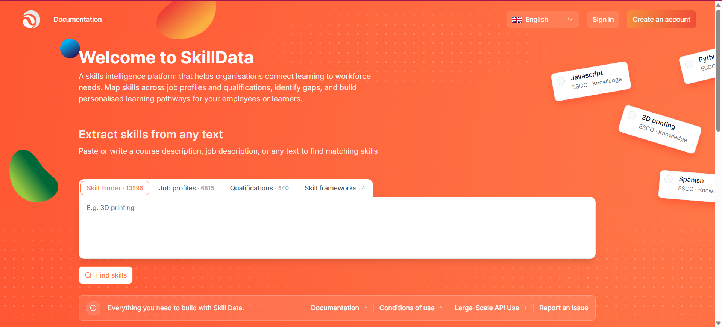
Try the Skill Framework Builder
Skill Framework Builder is designed to help you easily create, manage, and export machine-readable skill frameworks.
Skill Framework Builder is designed to help you easily create, manage, and export machine-readable skill frameworks.
www.skilldata.info

Slide 31
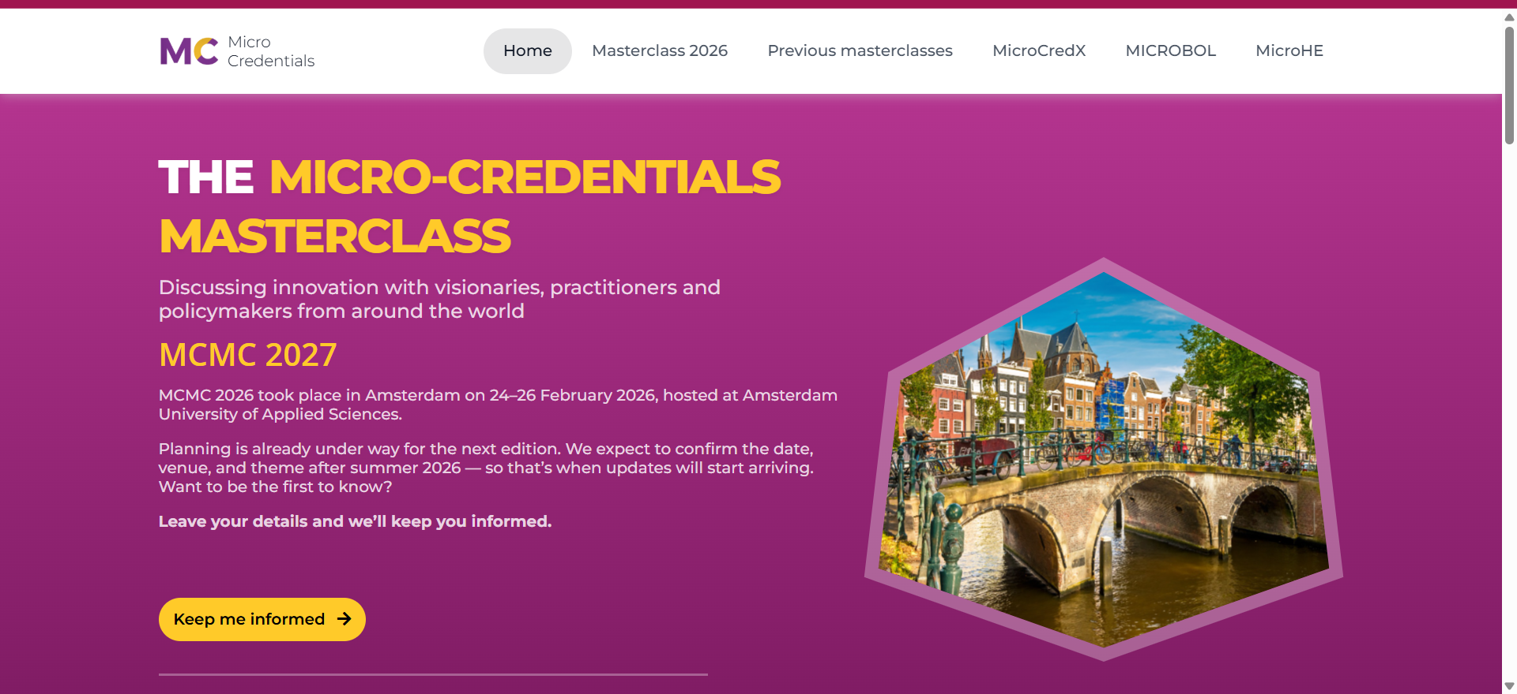
Micro-credentials Masterclasses
www.microcredentials.eu
The Micro-credentials Masterclasses are international learning and exchange events focused on how short, recognised learning experiences can support lifelong learning, employability and personalised career pathways.
They bring together education providers, policymakers, industry partners and experts to explore how micro-credentials can be designed, recognised, quality-assured and used across countries and sectors.

Slide 32
07
Translating Experience into Employer Language
Positioning Your Professional Identity

Slide 33
Name
Migrant Experience as Professional Capital
Your migration journey demonstrates:
Adaptability
Cross-cultural competence
Resilience
Systems navigation
Multilingual ability
Rapid learning capacity
These are strategic assets in EU labour markets.
A LITTLE PROGRESS EACH DAY ADDS UP TO BIG RESULTS
Notes:
Migration is not just a personal journey — it can also be strategic professional capital. The experience of relocating and adapting to a new country develops highly transferable skills that employers value across sectors.
European Commission (2021) Skills and Migration: Recognising Migrant Competences in the European Labour Market. Brussels: European Commission.

Slide 34
Overcoming “No Local Experience”
Reframe:
International experience =
Broader regulatory understanding
Multi-system comparison
Global professional perspective
Cultural intelligence
Employers value diversity in innovation-driven sectors. to type
Notes:
One of the common barriers for migrant professionals is the perception of “no local experience.” The key is to reframe your international experience as a competitive advantage.
Broader regulatory understanding – familiarity with multiple legal and organisational frameworks.
Multi-system comparison – insight into different processes, standards, and best practices.
Global professional perspective – awareness of international market trends and professional norms.
Cultural intelligence – ability to work effectively across diverse teams and contexts.
Employers increasingly recognise that these competencies enhance innovation, problem-solving, and adaptability, particularly in sectors driven by digital and green transformation. Positioning your experience this way can help overcome the “local experience” barrier and demonstrate strategic value.

Slide 35
08
Translating Experience into Employer Language
Action Planning

Slide 36
Complete:
• My strongest digital competency:
• My strongest green-related competency:
• A sector aligned with my expertise:
• One role I could realistically target:
• One skill gap I need to address:
Strategic Self-Assessment
30-Day Professional Activation Plan
Within 30 days I will:
Research 5 relevant job descriptions.
Update my CV using competency language.
Identify one targeted micro-credential.
Connect with 2 professionals in my sector.
Register on at least one EU job mobility platform.
Notes:
Identify your strongest digital competency and green-related competency — these are your current professional assets.
Consider a sector aligned with your expertise and one role you could realistically target — this keeps your focus achievable.
Highlight one skill gap you need to address, which helps prioritise upskilling.
Next, translate this assessment into a 30-Day Professional Activation Plan. Within a month, you can:
Research five relevant job descriptions to understand employer expectations.
Update your CV using competency language to highlight impact and results.
Identify one targeted micro-credential to close a priority skills gap.
Connect with two professionals in your sector to expand your network and gather insights.
Register on at least one EU job mobility platform to access job opportunities and labour market intelligence.
By combining self-awareness, skill mapping, and targeted action, this approach enables professionals to position themselves strategically in the EU labour market — maximising the value of their existing competencies while addressing key gaps.

Slide 37

Final Reflection
Ask yourself:
What did I underestimate about my skills?
What structural opportunities exist in my sector?
What is my next strategic move?
Complete:
• My strongest digital competency:
• My strongest green-related competency:
• A sector aligned with my expertise:
• One role I could realistically target:
• One skill gap I need to address:
Strategic Self-Assessment
Key Takeaways
30-Day Professional Activation Plan
Within 30 days I will:
• Research 5 relevant job descriptions.
• Update my CV using competency language.
• Identify one targeted micro-credential.
• Connect with 2 professionals in my sector.
• Register on at least one EU job mobility platform.
You are not starting again, but repositioning existing capital.
Digital and Green transitions require experienced professionals.
Your expertise has transferable value in Europe.
Notes:
Take a moment to reflect strategically:
What did I underestimate about my skills? Many of your digital, green, and professional competencies may already be highly relevant, even if you haven’t labelled them as such.
What structural opportunities exist in my sector? Consider emerging roles, labour market shifts, and EU-funded initiatives like the Twin Transition.
What is my next strategic move? Identify the immediate steps you can take to leverage your existing expertise and close any high-impact skill gaps.
Key Takeaways
You are not starting again — you are repositioning your existing professional capital to align with labour market needs.
The digital and green transitions create demand for experienced professionals who can adapt, integrate, and lead within evolving sectors.
Your existing expertise has transferable value in Europe, and with targeted upskilling or strategic positioning, you can access rewarding professional opportunities.

Slide 38
Recognise. Reframe. Activate.
Thrive in Europe’s Labour Market.

Slide 39

Follow our journey
li
in
www.promoteproject.eu

