Slide 1





Career Reintegration for Highly Skilled Migrant Women

Slide 2

Module 1
My Skills, My Story
Mapping My Qualification and Career

Slide 3

CONTENTS
01
Recognition Systems
02
Career Pathways Mapping
03
Skill Translation
04
Navigating Bureaucracy
05
Emotional Barriers

Slide 4
Learning Outcomes
By the end of this module, learners will be able to:
Identify their existing skills, experience and strengths.
Translate these skills into possible career opportunities in a new labour market.
Map a personal career pathway, including realistic next steps.
Recognise possible barriers and support options for moving forward.
Create a short action plan for their next career step.

Slide 5

01
Recognition Systems

Slide 6
Recognition Systems
For many high-skilled migrants arriving in the European Union, having their academic and professional qualifications officially recognized is a key step to fully access their profession.
The first step is to understand the difference between:
Regulated professions (e.g., doctors, lawyers, architects): you must obtain formal recognition before you can legally work. Each country has a designated authority for this.
Non-regulated professions (e.g., many roles in IT, business): recognition is not always mandatory, but employers may still request validation of your credentials.

Slide 7
Recognition Systems
The EU provides tools to simplify this process, such as:
ENIC–NARIC Network (official qualification recognition):
https://www.enic-naric.net/
ESCO – European Skills, Competences and Occupations:
https://esco.ec.europa.eu/
EU guidance on regulated professions:
https://single-market-economy.ec.europa.eu

Slide 8
Recognition Systems
Typical steps in the process
Submit your diploma(s), transcripts, and sometimes proof of work experience.
Provide certified translations into the official language of the host country.
Pay an application fee.
Wait for assessment—this can take weeks to months.

Slide 9
Recognition Systems
Practical tips
Start the process early—even before arrival if possible.
Check country-specific requirements, as procedures vary widely.
Keep digital and physical copies of all documents.
If your profession is in high demand, some countries offer fast-track procedures.

Slide 10
Recognition Systems
Practical Activity: Personal Roadmap
From arriving to a new country to entering de job market. Think about your journey and start to draw your roadmap. Use the following questions as a starting point:
When did you arrive to this country?
What qualification do you have?
Is your profession regulated in this country?
Which would be the equivalent profession in your current country?
What jobs did you do before?

Slide 11

02
Career Pathways Mapping

Slide 12
Career Pathways Mapping
In many cases, migrants arrive in the European Union with strong qualifications and expectations of immediate entry into equivalent senior roles. When that does not happen, entry-level or transitional positions can feel like a setback. However, entry roles can be better understood as deliberate stepping stones that serve several strategic functions.
Furthermore, a key source of stress could be the idea that there is only one “correct” path: immediate equivalence to their previous role. Encouraging multiple pathway options helps reduce this pressure.

Slide 13
Career Pathways Mapping
Rather than viewing them as “downward mobility,” entry roles can be seen as a way to:
Enter the local labour market quickly, avoiding long unemployment gaps that can weaken employability.
Build local experience, which is often more valued than foreign experience alone in hiring decisions.
Develop contextual knowledge, including workplace culture, regulatory norms, and communication styles.
Expand professional networks, which are critical for accessing higher-level opportunities later.
From this perspective, an initial role is not the end destination but a positioning move that increases long-term trajectory options.

Slide 14
Career Pathways Mapping
Practical Activity: Create your SWOT matrix
To better understand your personal situation and reflect on how every experience previously achieved can help you reach your career goals identify your Strengths, Weaknesses, Opportunities, and Threats in your journey to find a job.
Strengths → What you do well
Weaknesses → What you need to improve
Opportunities → External factors that can help you
Threats → External difficulties or barriers

Slide 15
Career Pathways Mapping
SWOT Matrix Example
Strengths
  Strong analytical skills
  5 years engineering experience, Fluent in English
Weaknesses
  Limited local language
  No local experience
  Unfamiliar with regulations
Opportunities
  High demand in IT/engineering
  Access to training programs
  Networking events
Threats
  Diploma recognition delays
  Strong local competition
  Bureaucratic procedures

Slide 16

Turn Your SWOT Into a Career Map
After completing your SWOT matrix, use it to build a practical career pathway — not just understanding where you are, but deciding what steps move you closer to the career you want.
Strengths → Direction
1
Match your strongest skills, experience, and qualifications to roles or sectors where they're valued.
Weaknesses → Action
2
Choose 1–2 weaknesses that could block progress — e.g., a language course or mentoring on regulations.
Opportunities → Now
3
Select realistic options: training programs, networking events, internships, volunteering, or professional associations.
Threats → Backup Plan
4
Plan alternatives for barriers like recognition delays — apply for entry-level roles or build your network while waiting.

Slide 17


Your Next 3 Actions
Your Career Map: Target role → Skills to strengthen → Opportunities to use → Barriers to manage → Next 3 actions
Example Actions
Contact the diploma recognition office and check required documents.
Register for a sector-specific language or professional communication course.
Attend one networking event for women in engineering or IT.

Slide 18
03
Skill Translation

Slide 19
Skill Translation: identification of competences
For high-skilled migrants, competences are often not fully captured by diplomas alone. A useful starting point for skills recognition and career development in the European Union is the use of shared European competence frameworks such as DigComp, LifeComp, GreenComp, and EntreComp to make competences more visible, comparable, and developable across countries and sectors.

Slide 20
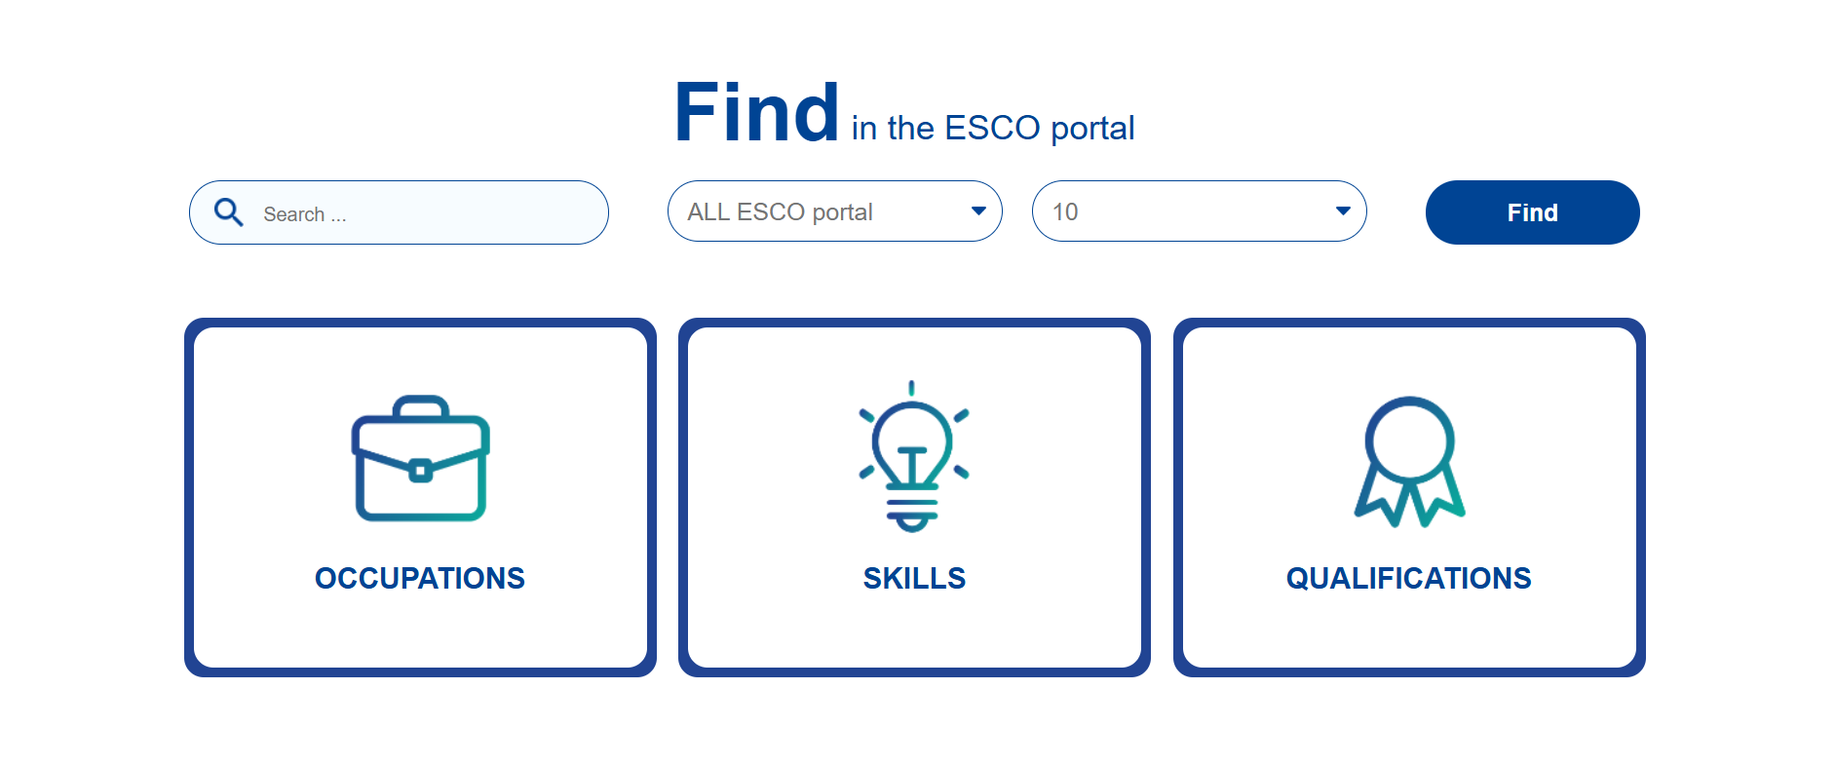
CLICK ON THE IMAGE
Using ESCO to Map Careers Across Europe
CLICK ON THE IMAGE
EURES mapping tables connect national occupations and skills to ESCO, supporting job matching across languages and countries. Learners can use them to compare their current role, skills and experience with labour market terminology in another European country, helping them identify target roles, skills gaps and next steps.

Slide 21
Skill Translation: Identification of competences
DigComp (Digital Competence Framework)
  Focuses on digital literacy and skills needed in modern workplaces. It is widely used to assess digital readiness across roles, from basic office work to advanced tech positions.
LifeComp (Personal, Social and Learning to Learn Competence Framework)
  Centers on personal development and adaptability. It is particularly relevant for integration, as it supports adaptation to new cultural and professional environments.

Slide 22
Skill Translation: Identification of competences
EntreComp (Entrepreneurship Competence Framework)
  Covers entrepreneurial skills applicable beyond starting businesses, including initiative-taking, creativity, opportunity recognition, and resource management. It is useful for innovation roles, project management, and career transitions.
  GreenComp (European Sustainability Competence Framework)
  Defines competences related to sustainability and environmental awareness. It is increasingly important as many sectors integrate sustainability goals into core operations.

Slide 23
Skill Translation: identification of competences
These tools can be used to:
Build a structured skills portfolio for job applications
Translate international experience into locally understandable terms
Identify skill gaps for targeted upskilling
Support interviews by articulating competences clearly and confidently

Slide 24

Skill Translation: identification of competences
This is the first part of a series of 6 videos titled ‘You, your degree and the skills employers want to see’ produced by Cambridge University Careers Service. These videos may be useful for women to help them break down their professional experience into skills so that they can then complete the proposed activity.
CLICK ON THE IMAGE
Notes:
This is the first part of a series of 6 videos titled ‘You, your degree and the skills employers want to see’ produced by Cambridge University Careers Service. These videos may be useful for women to help them break down their professional experience into skills so that they can then complete the proposed activity.

Slide 25
Skill Translation
Practical Activity: From Diploma to Skills
Sometimes, your diploma or previous job is not directly recognized in a new country. However, your skills are still valuable.
Identify and transform your past education and job experience into practical skills that match current job opportunities.
Transform your tasks into skills.
In which other jobs can you use these skills?
Notes:
Each women selects a task they developed in their previous job and try to break it down into several skills.

Slide 26
04
Navigating Bureaucracy

Slide 27
Navigating Bureaucracy
The recognition process of foreign qualifications and diplomas in the EU is a multi-stage administrative and expert evaluation system involving academic centres, professional regulators, and national ministries.
The exact process, as well as the timeline, varies by country, but the overall architecture is broadly similar and depends heavily on whether the profession is regulated and how complex the qualification comparison is.

Slide 28
Navigating Bureaucracy
STEPS
Identification of competent authority
Application submission
Administrative verification
Academic and professional assessment
Decision phase
Who is involved?
What happens?
What authorities do?
What they asses?
Possible outcomes?

Slide 29
Navigating Bureaucracy
1. Identification of competent authority - Who is involved?
Typical authorities include:
National ENIC-NARIC centres (for academic recognition of diplomas)
Ministries of Education (general academic equivalence)
Professional regulatory bodies (for regulated professions such as medicine, law, engineering)
Sector-specific chambers (e.g. medical councils, bar associations, engineering boards)

Slide 30
Navigating Bureaucracy
2. Application submission - What happens?
Documents usually required:
Degree/diploma certificates
Academic transcripts
Proof of professional experience
Passport or ID
Certified translations (often mandatory)
Curriculum or course descriptions (in some cases)

Slide 31
Navigating Bureaucracy
3. Administrative verification - What authorities do:
Check if the file is complete
Request missing documents if needed
Verify authenticity of documents (sometimes via issuing universities or embassies)
Typical issues:
Missing apostille/legalisation
Non-certified translations
Unclear curriculum comparability

Slide 32
Navigating Bureaucracy
4. Academic and professional assessment - What they assess:
Level of education (EQF alignment)
Duration of studies
Curriculum content comparison
Professional competencies and training hours
This is the most time-consuming step.

Slide 33
Navigating Bureaucracy
5. Decision phase - Possible outcomes:
Full recognition → qualification fully accepted
Partial recognition → additional requirements imposed
Non-recognition → qualification not considered equivalent
Additional requirements may include:
Adaptation periods (supervised work)
Aptitude exams
Additional courses or retraining

Slide 34
Navigating Bureaucracy
Practical Activity: What I’m waiting for vs What I can do now
Based on the previous guide identify the following:
In which phase am I?
What am I missing?
What are the required documents?
Bureaucracy can be heavy and frustrating, but it doesn’t have to stop your progress. Waiting is part of the process, but it does not mean standing still. Make groups and reflect on:
What am waiting for?
What can I do meanwhile?
Which actions are in your control right now?

Slide 35
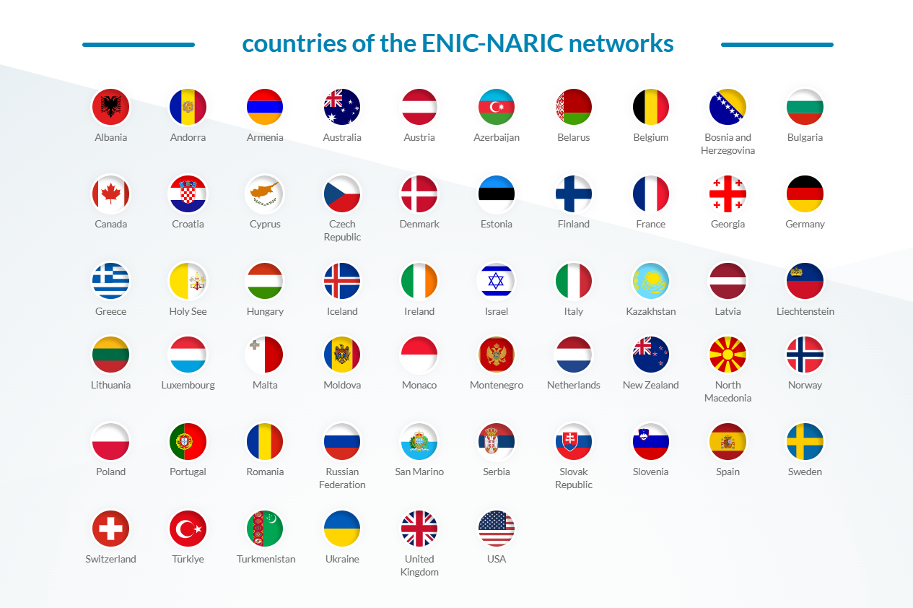
Recognising Foreign Qualifications with ENIC-NARIC
www.enic-naric.net
ENIC-NARIC helps people understand how their foreign qualifications are recognised in another country. For female professionals mapping their career, it is a key step to check whether their diploma, degree or professional qualification is accepted, whether formal recognition is needed, and which national authority to contact.
This helps turn a career goal into a realistic action plan:
target role → qualification check → recognition steps → documents needed → next career move.

Slide 36

By the end of this module, we hope you have:
Identified your skills and learned how to translate them into new career opportunities.
Reflected on your career pathway and defined your next steps forward.
Gained confidence to move forward, managing challenges with resilience and support.

Slide 37
05
Emotional Barriers

Slide 38
Emotional Barriers
Starting a new life and rebuilding a career in a different country is not only a practical challenge — it is also an emotional journey. Feelings such as uncertainty, frustration, or self-doubt are common and completely valid. Recognizing these emotional barriers is the first step towards managing them and moving forward with confidence.
Useful tips:
Build your support network—connect with people who understand your journey.
Put your mental health first, ask for profesisonal help if neccessary.
Be kind to yourself—progress takes time, and every small step counts.
Give yourself space for migratory mourning—it’s okay to grieve what you left behind.

Slide 39
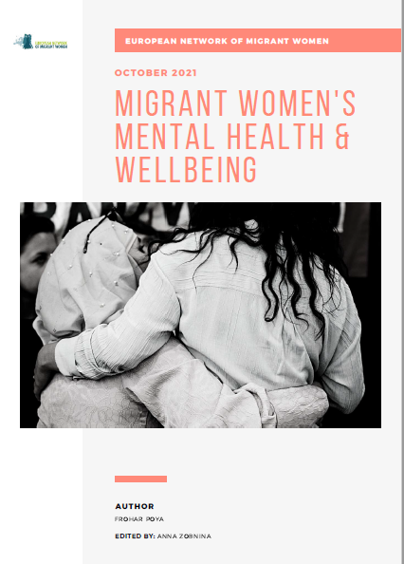
Emotional Barriers
Further reading:
Poya, F. (2021). Migrant women’s mental health & wellbeing. European Network of Migrant Women.
- Link to the report.
Notes:
This report may be useful for both women and facilitators. We selected the report because we consider that some of its content is extremely relevant (we understand that other parts may not correspond to our particular aim). Although the topic may be sensitive and difficult to address depending on the situation, we believe that the testimonies from the report may serve as a helpful introduction to the reflection activity.

Slide 40
Emotional Barriers
Practical Activity: Reflection
Depending on how you feel about sharing your experience make a group or individual reflection about:
A challenge your are currently facing and how does it make you feel.
Define one action you can take this week (contact someone, update CV).
Starting from the SWOT matrix, develop a positive reflection towards the future.

Slide 41

Follow our journey
li
in
www.promoteproject.eu

