Slide 1


Labour Market Report
IRELAND
2025
Labour Market Report
By
PROMOTE

Slide 2

CONTENTS
01
Introduction into Labour Market research
02
Key Findings in Skills Development
03
Key findings in Employment of Highly Skilled Migrant Women
04
Key findings in Training and Development
05
Key findings in Future trends and Industry Needs
06
Key findings in Workplace culture and diversity
07
Conclusion and recommendations
© 2024. PROMOTE Project. This work is openly licensed via CC BY 4.0.

Slide 3

01
INTRODUCTION

Slide 4
Overview of the Labour Market Analysis and Methodology
This Labour Market Report presents the findings of field research which was conducted with four companies operating in Ireland across a range of sectors:
an ingredients distribution company,
a manufacturing and engineering firm,
a digital and sustainability training provider (Veri Training),
an innovation-led construction company (Futurecast).
The research explored employers’ experiences and insights in five key areas; skills gaps, employment of highly skilled migrant women, training practices, emerging industry trends, and inclusive workplace culture.
The companies were selected to reflect a mix of traditional and knowledge-based industries. While their workforce needs differ, several common themes emerged, particularly in relation to the challenges posed by digital transformation, talent development, and the limited integration of migrant women into high-skilled roles.

Slide 5

02
Key Findings in
the Skills Gap

Slide 6
Key Findings in Skills Development
All four employers identified specific skills gaps, though the nature of these varied significantly depending on sector and internal organisational focus.
The Ingredients Company stressed the absence of soft skills among younger workers. The interviewee explained that many applicants lacked fundamental attributes such as reliability, punctuality, and responsibility. Digital skills were not a current priority but anticipated as important in future. The company was particularly concerned about young workers' “lack of accountability” and diminishing work ethic, noting that some appeared to expect progression without effort.
By contrast, the Manufacturing Company identified pressing shortages in both commercial and strategic roles. While it can fill entry-level positions, it struggles to recruit for senior roles requiring leadership, business acumen, and a wider commercial lens. It also noted a lack of forward-thinking skills in fields like AI, with a need for employees who “understand not just how to use the technology but how to think with it.”

Slide 7

Key Findings in Skills Development
Veri Training offered a digital education provider’s perspective, identifying major gaps in cybersecurity, data analytics, cloud computing, DevOps, and AI. These gaps, it noted, affect both its own workforce and the learners it serves through upskilling programmes. Sustainability-related skills were also in demand, particularly among software developers. Their own training audits show strong internal interest in project management and green skill development.
Futurecast, operating at the cutting edge of construction and innovation, pointed to the erosion of critical thinking skills. They attributed this to an overreliance on generative AI tools. They also highlighted the need for advanced digital transformation and automation skills, along with practical knowledge in sustainability and circular economy practices such as waste reuse in construction.

Slide 8
03
Key Findings in
the Employment
of Highly Skilled
Migrant Women

Slide 9

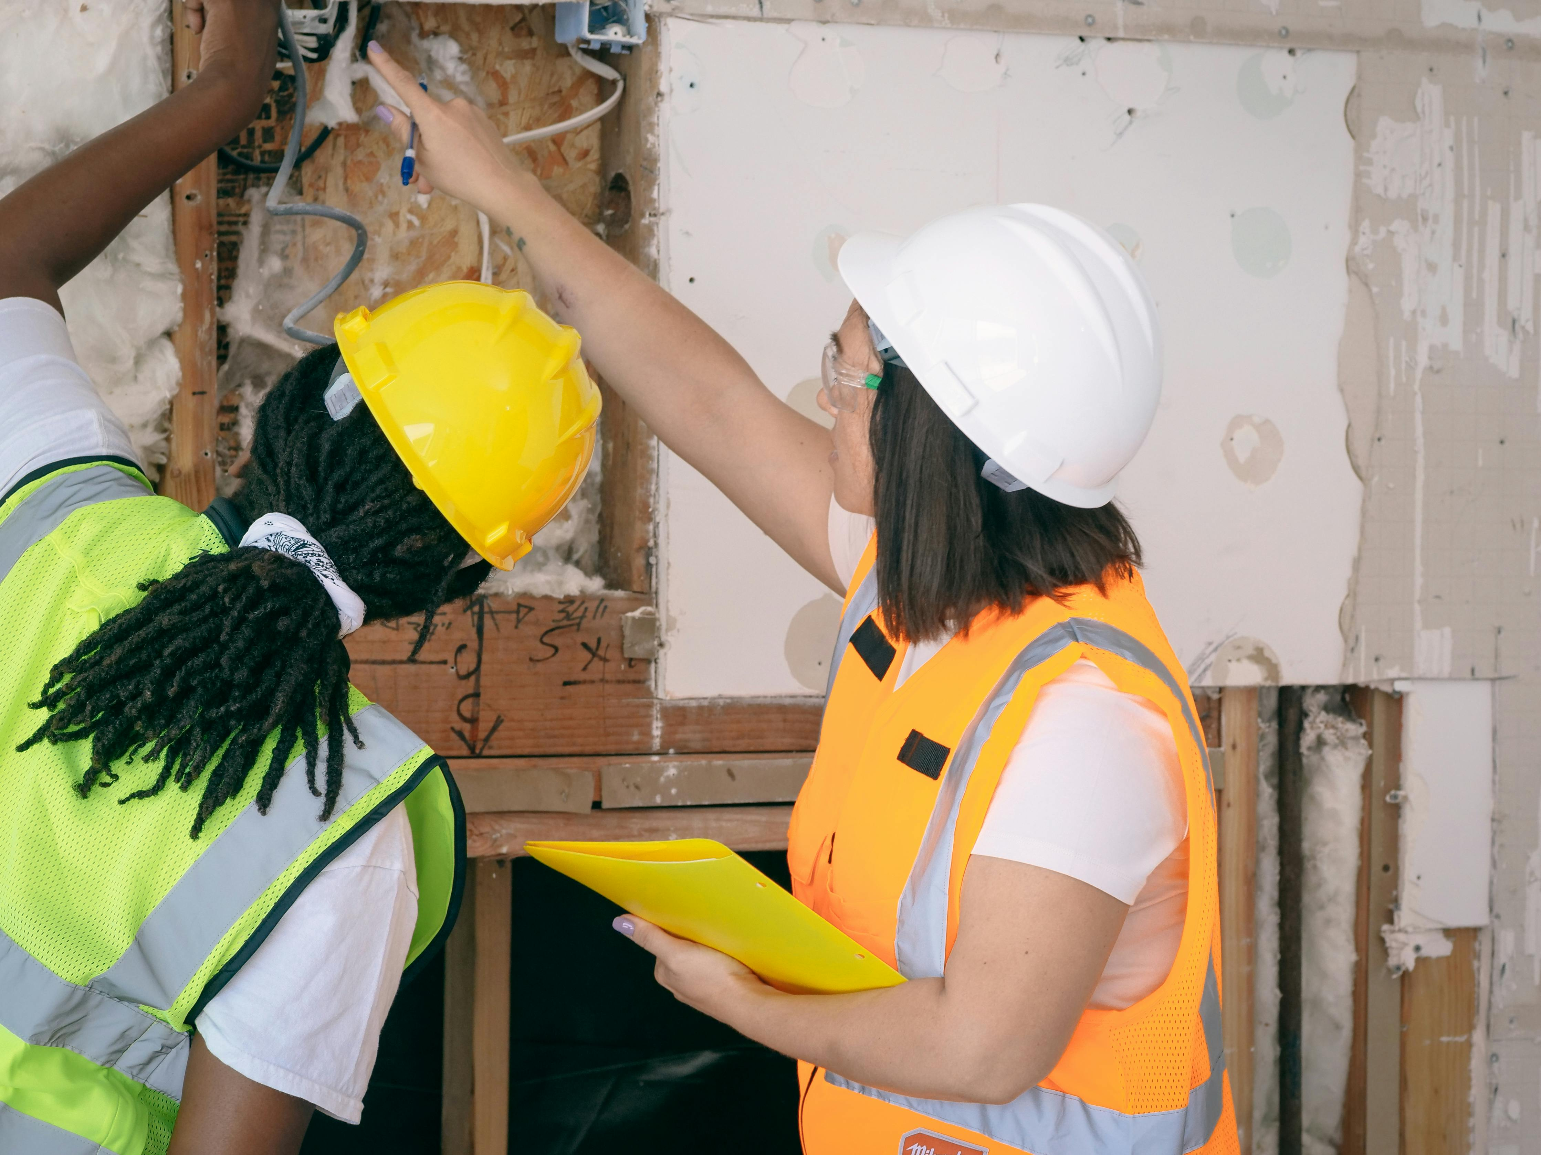
EMPLOYMENT OF HIGHLY SKILLED MIGRANT WOMEN
Across the four companies, there is a general openness to employing highly skilled migrant women. However, actual experience varies significantly. Neither the Ingredients Company nor the Manufacturing Company has hired highly skilled migrant women, although both have experience with employing migrants in entry-level roles, some of whom have progressed into supervisory positions. They expressed genuine interest in diversifying their workforce and acknowledged the potential value migrant women could bring, including new perspectives, cultural diversity, and strong work ethics.

Slide 10
Key Findings in Employment of Highly Skilled Migrant Women
Despite this openness, both companies identified structural and cultural barriers. A major issue is that highly skilled migrant women rarely apply for roles, limiting their visibility within recruitment pipelines. There is also a perceived gap in management’s understanding of how to support such hires. The Manufacturing Company suggested that hiring managers could benefit from education and workshops on inclusive hiring practices and cultural integration. It saw potential for partnerships with government bodies or NGOs that could help normalise the idea of diversity at senior levels. Currently, it relies on internal mentoring, particularly from multilingual managers, to support onboarding and integration for migrant employees at operational levels.
The Ingredients Company similarly identified a lack of knowledge around how to access skilled migrant women, and requested more structured onboarding support, communication strategies, and training materials tailored to migrant women’s needs. They recognised that cultural fit, communication style, and adjustment to corporate culture can be challenging, particularly in a small company environment. While they were not opposed to hiring migrant women, they were cautious and expressed the need for more guidance and tools to make it a success.

Slide 11

Key Findings in Employment of Highly Skilled Migrant Women
In contrast, Veri Training and Futurecast both have direct experience employing women from migrant and refugee backgrounds. Futurecast, in particular, has developed a structured programme funded by the EU Just Transition Fund, establishing a mechanical and electrical engineering training centre in Ballaghaderreen. While not exclusively aimed at migrant women, this initiative targets expat and refugee workers and reflects a proactive approach to broadening access to skilled roles. Futurecast also supports its inclusive hiring practices with mentorship, onboarding pathways, and accessible job descriptions.
Veri Training employs several migrant women and describes their contributions as highly positive. The company supports integration through universal design learning principles, flexible working arrangements, and translation tools such as immersive readers and Google Translate. However, they noted that language, trauma, and housing instability remain major barriers to retention and progression.

Slide 12
04
Key Findings in
Training and
Development

Slide 13

Key Findings in Training and Development
All four companies interviewed demonstrate a clear commitment to training and development, though the formality and focus of their approaches vary. Across the board, employers expressed support for initiatives that would enable highly skilled migrant women to succeed, even if they had not yet implemented specific strategies targeting this group.
Both the Ingredients Company and the Manufacturing Company operate formal onboarding processes led by HR departments. These cover core topics such as company history, organisational structure, employment terms, and key policies, followed by role-specific training on topics such as health and safety, customer service, and product knowledge. These structured induction procedures help set expectations and support initial integration.

Slide 14
Key Findings in Training and Development
In terms of delivery formats, the Ingredients Company prefers in-person and on-the-job training, valuing its role in building relationships, encouraging collaboration, and reducing communication barriers. They complement this with some online training, especially for software tools such as Sage. The Manufacturing Company takes a blended approach, acknowledging the value of online training for geographically dispersed teams, while maintaining a preference for face-to-face workshops when it comes to team building, brainstorming, and collaboration. This reflects a growing understanding of how modular and flexible training models can be tailored to different contexts and learner needs.

Slide 15

Key Findings in Training and Development
Neither of these two companies currently offers training or career progression pathways specifically designed for highly skilled migrant women. However, both expressed openness to developing more inclusive and responsive practices. The Ingredients Company is open to integrating migrant women into skilled roles, provided appropriate onboarding, communication support, and targeted training are in place. The Manufacturing Company fills roles through open competition and merit-based recruitment, but recognises that migrant employees already in the workforce have progressed informally from entry-level to supervisory roles, indicating the existence of internal advancement opportunities, albeit without formal structures.
In contrast, Veri Training and Futurecast have taken more proactive steps. Veri conducts regular internal training audits to understand employee interests and align them with emerging needs. Their training offer includes sustainability audits, digital tools, project management, and role-specific learning, delivered through a blended model that includes e-learning and external certifications. The company prioritises staff agency and feedback in shaping its learning offer.

Slide 16
Key Findings in Training and Development
Futurecast has implemented a structured, inclusive training strategy. New employees undergo initial assessments to determine learning needs, and training is then adapted to suit the individual. The company blends online and classroom-based formats and integrates bridging programmes and apprenticeships targeting marginalised groups. Notably, their mechanical and electrical engineering training centre in Ballaghaderreen serves expat and refugee workers, offering paid six-month placements that can lead to long-term employment. Futurecast also integrates mentorship and clear career progression pathways, setting it apart in terms of inclusive training design.
Across all four organisations, there is a general consensus that training must be flexible, context-sensitive, and aligned with both individual and organisational development goals. While the degree of formalisation varies, employers increasingly recognise the value of blended approaches, the need for soft skills alongside technical training, and the importance of adapting content and delivery to diverse learner needs, including those of migrant women.

Slide 17

“Any quotes from employers include here”

Slide 18
05
Key Findings in
Future trends
and Industry
needs

Slide 19
FUTURE TRENDS AND INDUSTRY NEEDS
Across all four companies, there is a shared understanding that the Irish labour market is undergoing rapid transformation, shaped by digitalisation, sustainability imperatives, and evolving business models. These changes are expected to significantly influence workforce structures, skills demand, and role expectations.
Artificial intelligence (AI) is recognised as a key driver of change, particularly by Veri Training, which anticipates a surge in demand for AI-literate professionals across sectors. They also point to the emerging need for ethical frameworks and responsible AI use, especially in client-facing services and educational products. Similarly, Futurecast sees AI and automation as essential to future operations, but warns of their impact on critical thinking, arguing that overreliance on AI tools can dull human judgment and problem-solving capacity.

Slide 20
Key Findings in Future Trends and Industry Needs
The Manufacturing Company also sees AI as an opportunity, particularly in streamlining repetitive tasks in sales and procurement, to free up employee time for more strategic work. However, their most immediate focus is on the digitalisation of stock control systems, as they transition away from paper-based inventory tracking. This shift demands digital competencies, including comfort with data systems, dashboards, and integrated warehouse tools. They do not foresee the creation of entirely new departments, but rather expect increased role restructuring and cross-training of existing staff to meet the demands of digital growth and internal efficiencies.
Leadership and people management skills are also becoming more critical in manufacturing, especially as teams grow more diverse and hybrid work settings require stronger communication and supervisory skills. The company anticipates greater investment in mid-level leadership development, especially for staff progressing from operational roles.

Slide 21

In the Ingredients Company, although technological adoption is slower, there is a growing awareness of future shifts. The company acknowledges that evolving industry standards, particularly around ESG (Environmental, Social, and Governance) strategies and compliance reporting, are likely to introduce new documentation and reporting responsibilities. These changes may require upskilling in regulatory literacy and sustainability awareness, particularly among customer-facing staff.
Futurecast is already responding to such trends. It is developing roles around sustainability tracking, circular economy innovation, and industrial design. The company is shifting towards an innovation-centred model, expanding departments involved in product testing, prototyping, and sustainable materials. They anticipate that traditional job roles will need to blend technical, digital, and sustainability knowledge, especially in construction and design roles. In addition, they note the growing importance of interdisciplinary collaboration, which requires both soft and hard skill integration.

Slide 22
06
Key Findings in
Workplace
Culture and
Diversity

Slide 23
WORKPLACE CULTURE AND DIVERSITY
All four companies interviewed expressed a commitment to fostering inclusive workplace cultures, though the level of maturity and formalisation of Diversity, Equality, and Inclusion (DEI) practices varied. The companies engaged in EU-funded or socially driven projects,Futurecast and Veri Training, demonstrate more advanced DEI frameworks, while the Ingredients Company and Manufacturing Company acknowledge the importance of inclusion but are still developing structured approaches.
Futurecast has embedded DEI principles into its recruitment processes, training programmes, and broader organisational culture. It emphasises accessible language in job descriptions, offers tailored support for onboarding, and facilitates structured mentorship and progression pathways. DEI considerations are embedded in its EU-funded initiatives, and the organisation actively promotes a workplace culture in which diverse experiences are seen as assets to innovation and performance.

Slide 24

WORKPLACE CULTURE AND DIVERSITY
Similarly, Veri Training has a formal DEI policy and consciously designs inclusive practices into its daily operations. This includes flexible working arrangements (such as hybrid or part-time roles), digital accessibility tools, and staff surveys to assess wellbeing and inclusion. Migrant women currently employed by the organisation are supported through informal mentorship, regular feedback opportunities, and an inclusive, values-driven culture. The company leverages tools like Google Translate and immersive readers to support staff for whom English is not a first language.
The Ingredients Company also has a DEI policy in place, recognising the increasing cultural diversity of its workforce. However, it admits that more work is needed to turn policy into practice, particularly in terms of supporting cultural integration and ensuring that all employees feel included and supported. The organisation is open to improving its approach and is particularly interested in gaining better access to resources, guidance, and training on supporting the integration of skilled migrant women. It already offers flexible work arrangements and informal support mechanisms, especially for working mothers, and values one-to-one relationship building in small team environments.

Slide 25

The Manufacturing Company similarly acknowledges that DEI is an area requiring further growth, particularly at senior leadership levels. Management is open to developing its understanding and skills in inclusive hiring and progression, and sees potential in collaborating with education providers or NGOs to build capacity in this area. Despite the absence of a formal DEI strategy, the company supports a multicultural workforce and benefits from multilingual managers who act as informal mentors and translators. This has proven valuable in easing communication challenges and helping entry-level migrants integrate into production roles. Notably, the company also provides flexible working arrangements, including hybrid work and accommodations for working parents.

Slide 26
“Any quotes from employers add in here**”

Slide 27
CONCLUSION AND RECOMMENDATIONS
This report highlights a shared recognition among Irish employers of the need to adapt to a more digital, diverse, and sustainability-driven labour market. Skills in AI, digital tools, ESG compliance, and critical thinking are increasingly valued, alongside soft skills and leadership.
While openness to hiring highly skilled migrant women exists, practical barriers remain, particularly around language, visibility, and cultural integration. Only two of the four companies have direct experience employing migrant women in skilled roles, but all expressed willingness to improve.
Training is a priority across all organisations, with blended learning models, structured onboarding, and internal upskilling pathways in place. DEI practices vary, but flexible work and informal support structures are common.
There is strong potential to build on existing good practice through targeted support, inclusive recruitment strategies, and employer education, enabling wider integration of migrant women into Ireland’s skilled workforce.
HEADING
Click to type..

Slide 28
www.promoteproject.eu
Follow Our Journey
li
in

